Slide 1
Interface 2023
The New Global Learner
Exploring Virtual Exchange
Megan Mocko, Denise Zornoff,
Ricardo Andrez Lopez Celi, and Jeffrey Pufahl

Slide 2
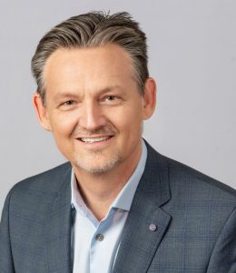
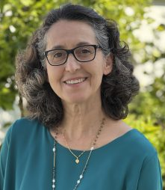
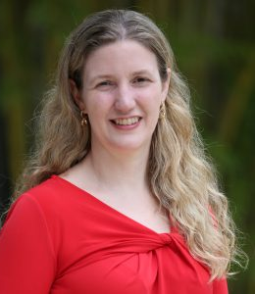
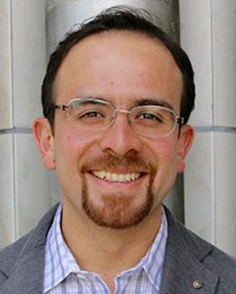
Jeffrey Pufahl
UF USA
Denise Zornoff
UNESP Brazil
Megan Mocko
UF USA
Ricardo Celi
USFQ Ecuador.

Slide 3
Session Objectives
Share two VE program examples
Analyze a VE Case Study and troubleshoot/improve on the activities
Develop a learning objective for a VE component of a course
Design an activity that fulfills the learning objective
Exchange and share your objectives and activities with other groups
Provide feedback and reflections on delivering VE modules

Slide 4
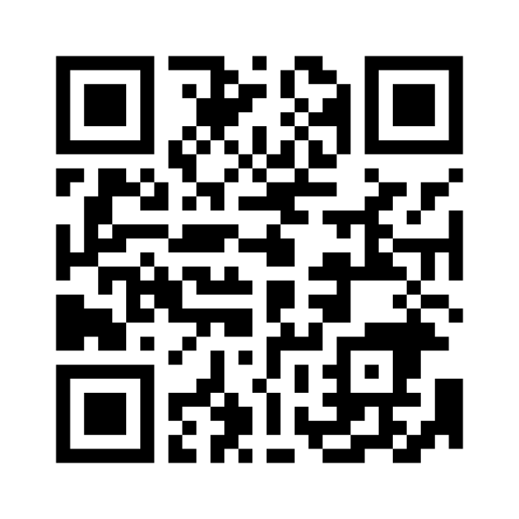
What is your experience with virtual exchange?
https://www.menti.com/alotn5zu4e4q

Slide 5
Program Examples
Global Borders and Belonging
Brazil/NL/US
Arts in Health - Investigated access to healthcare through lens of equity
Arts-based research/Qualitative Research
Developed short films: Research Dissemination
One full semester
Zoom/What’sApp/Canvas/Blackboard
Pre/post IntCRIT/IntCOMM survey
UF/University of San Francisco
Ecuador / US
Business Statistics - Ethics case study
Two sessions per semester
Ongoing IntCRIT and IntCOMM Survey translation to spanish
Zoom / Google Docs / D2L / Canvas
Pre/post IntCrit/IntComm UF Sp’23 / both Fa’23
First results to be presented at IVEC by the end of this year

Slide 6
Case Activity
Part I - VE Case study
Handouts will be distributed at classroom
Read it carefully
Part II - Designing Your Own Virtual Exchange
As a group, pick 1 Learning Objective:
Make sure it is SMART (Specific, Measurable, Achievable, Relevant, and Time-Bound)
Briefly describe the activity to be completed in the virtual exchange.
Add details about what the students should do to fulfil the Learning Objective.
Feedback from neighboring group.

