Slide 1
Bringing Groupwork from the Courtroom to the Classroom
Interface 2023
Professor Christopher D. Hampson

Slide 2
Overview of our 50 Minutes Together
Why groupwork engenders such bad feelings;
Why we should do it anyway;
Strategies for doing it right; and
Ways to implement these strategies in your fields.

Slide 3
2. Why We Should Do It Anyway

Slide 4
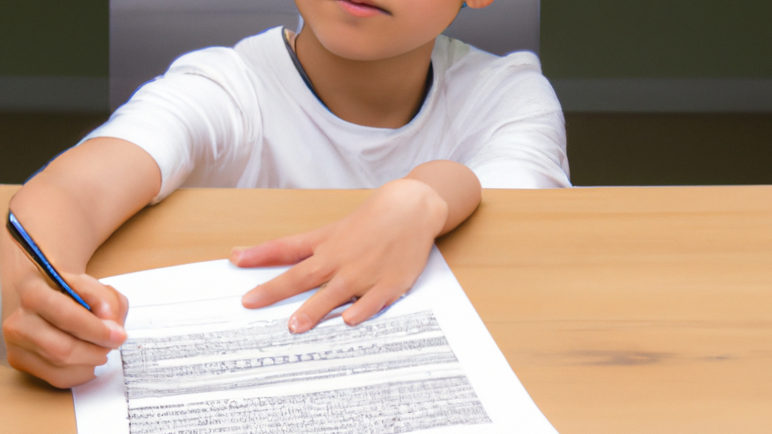
Metacognition, or learning about learning

Slide 5
Lawyers are counselors, drafters, negotiators, and advocates.

Slide 6
Four Key Principles for Group Projects
Authentic Assignment
Diverse Teams
Thoughtful Structure
Fair Assessment

Slide 7
3. Strategies for Doing It Right

Slide 8
Law Firms | Judges
Drafter (takes lead on writing Proposed Plan and any Motions) | Chief Judge (presides over hearing, calls the case at 11:00 a.m., keeps time for oral argument, adjourns the hearing at 11:55 a.m.)
Advocate (presents Plan and any motions to the Court; drafts Oral Argument Outline/Q&A) | Problem-Solving Judge (tries to get the Parties to reach consensus; sends them out of the room to negotiate if necessary)
1 or More Negotiators (spearheads conversations with opposing counsel; drafts Talking Points for negotiations) | By-the-Book Judge (makes sure Plan conforms to § 1129(a) and (b) and won’t be overturned on appeal, insists that the Court deny confirmation of Plans that don’t meet the Code’s requirements)

Slide 9
Assessment Rubric for Moot Chapter 11 Plan Confirmation Hearing
 | Group Component (70%) |  | Individual Component (30%)
 | Work Product (50%) | Process (20%)
5 | Work product shows mastery of bankruptcy law, as well as creative use of rules in negotiation. | Team divided work equitably by roles and adjusted appropriately as needed. | Individual demonstrated excellent insight into bankruptcy law and practice; brought creativity, finesse, or grit to the team; consummate team player.
4 | Work product shows clear understanding of bankruptcy law and practice, as well as assertive use of rules in negotiation. | Team divided work equally but not equitably; faced and overcame some challenges in implementation. | Individual demonstrated deep understanding of bankruptcy law and practice; brought best efforts to the team.
3 | Work product shows accurate understanding of bankruptcy law and practice. | Team attempted to divide work equally or equitably but faced serious challenges in implementation. | Individual demonstrated accurate understanding of bankruptcy law and practice; served the team capably and within their role.
2 | Work product shows moderate confusion about bankruptcy law and practice. | Team divided work unequally; some members overloaded and others freeloaded. | Individual demonstrated moderate confusion about bankruptcy law and practice; failed to carry weight on team.
1 | Work product shows serious unawareness of bankruptcy law and practice. | Team made no attempt to divide up work; faced serious problems with “AWOL” or “hero” members. | Individual demonstrated serious unawareness of bankruptcy law and practice; wholly failed to support team.

Slide 10
No single person was a hero, and no one took a back seat, we were constantly making sure we were all on the same page and even checked all of the motions and plans together at the end to make sure it was cohesive and error-free.
In our initial meeting, we agreed to divide the work as suggested in the assignment …. When the real work began, this was not followed even slightly. Our product was truly a result of collaborative process to the point where it would be difficult to label any one of us with one title.
We assigned each member a role, but we all participated in everything. Our whole team came to the negotiation and all participated. We also collectively brainstormed our strategy. We learned that we all work very well as a team and were all able to contribute, which is what I think led to the success we had in negotiation.
We followed the roles laid out in the project packet for the most part, but there was overlap and mutual contribution across ‘role lines.’

Slide 11
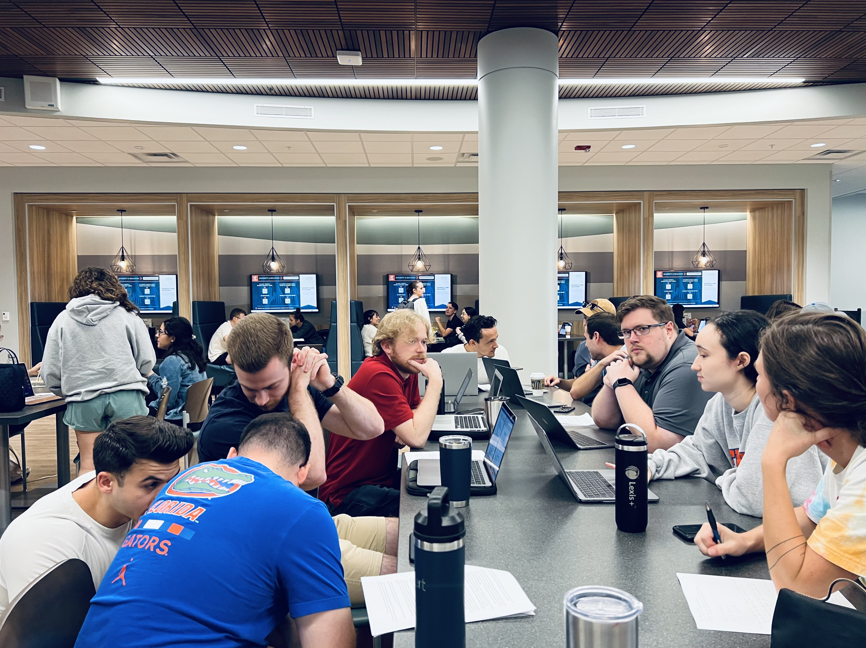

Slide 12
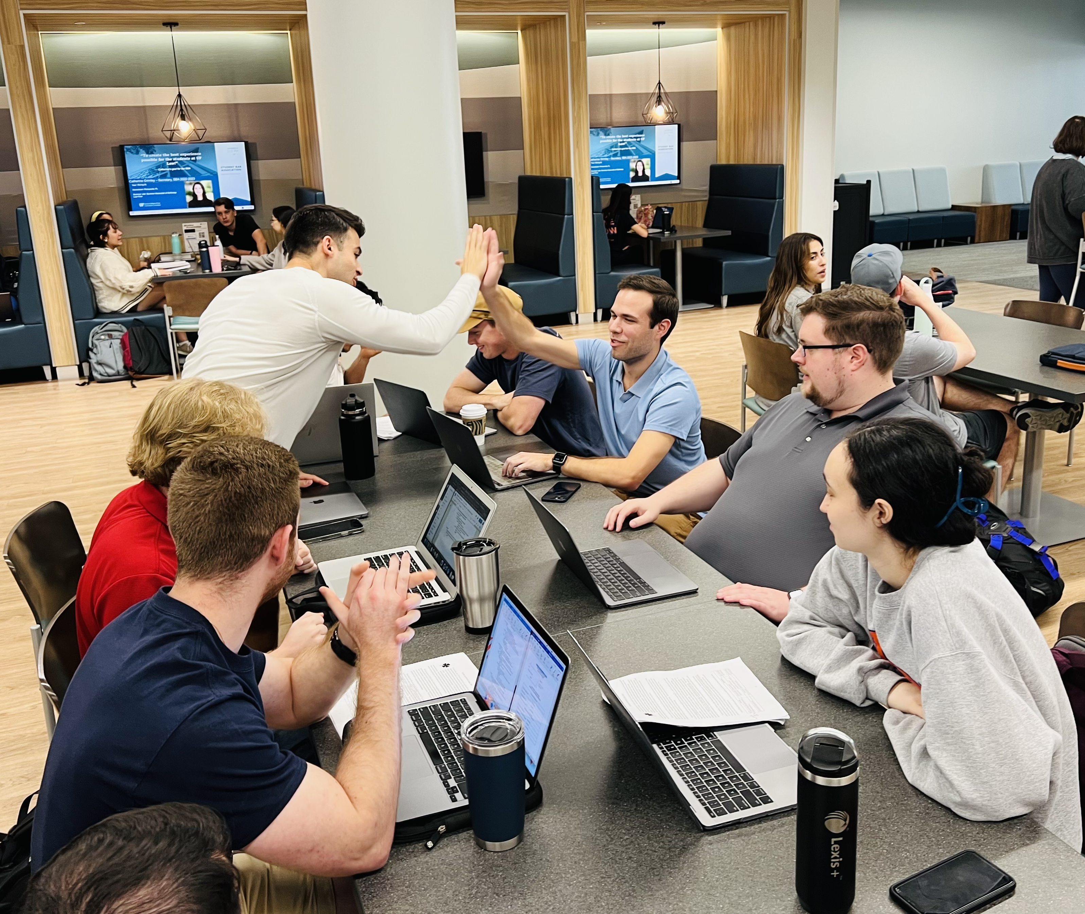

Slide 13
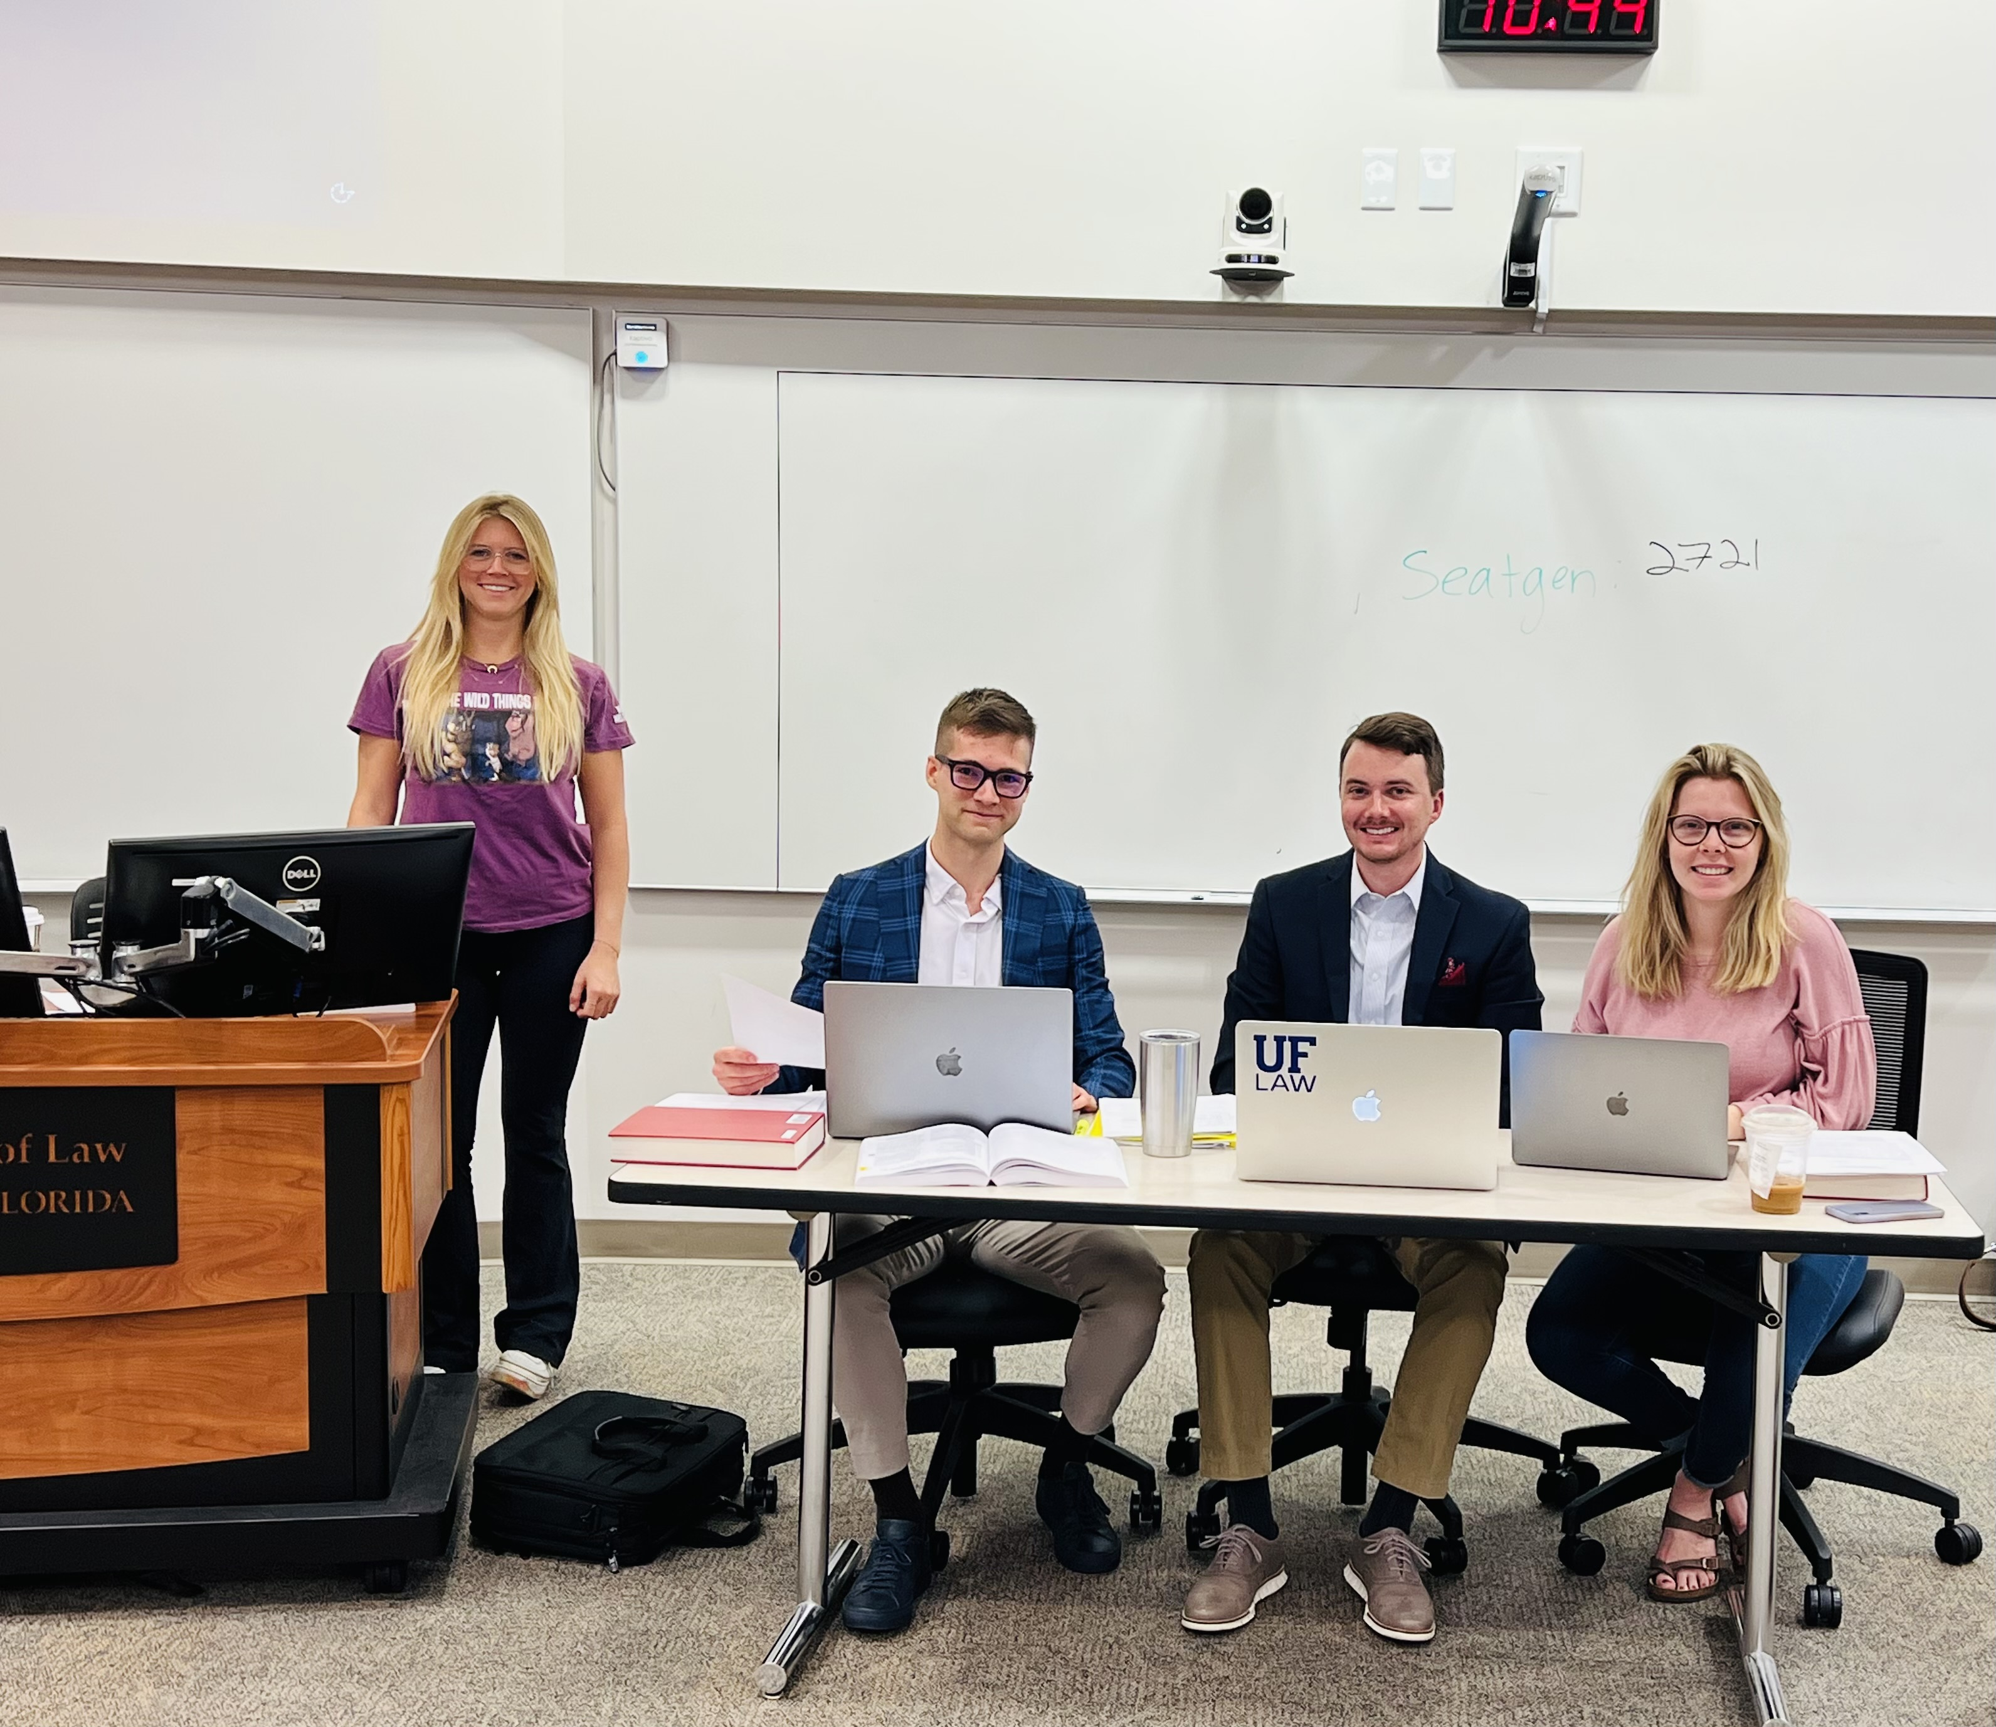

Slide 14
4. Ways to Implement These Strategies in Your Fields

Slide 15
Review of Principles
Authentic Assignment
Diverse Teams
Thoughtful Structure
Fair Assessment

Slide 16
Everyone knows that feeling of being in a group project, being dissatisfied with something, and taking it upon yourself to do everything on your own "the right way," and in real life there is just too much work and not enough time for that to ever be possible. You need to work together, trust each other, and perhaps most importantly, be someone worthy of that trust. And this experience was a great microcosm of that sort of environment and team relationship.
It was a great experience. I hope life will be similar.
My biggest takeaway from this experience is that working on a legal team is more productive than I thought it would be. Before groups were selected, I wasn’t sure whomever I was paired with would pull their weight. Thus, I was stoked to see everyone in my group not just fulfilling their duties, but also putting in extra elbow-grease to get this handled the best we could. Furthermore, I feel like going through the crucible together helped us all to have a common bond.
I think my biggest takeaway from the experience was that working as a team can be both enjoyable and uncomplicated.

Slide 17
The most important lesson that I have learned from this assignment is to not expect any compassion from lawyers in a bankruptcy proceeding.

Slide 18
Additional Resources
https://teach.ufl.edu/resource-library/group-work/
K. Patricia Cross et al., Collaborative Learning Techniques: A Handbook for College Faculty (2d ed. 2014)
hampson@law.ufl.edu

