Slide 1
We’ll be reviewing syllabi design today – feel free to pull up a recent syllabus of your own, or grab a handout

Slide 2
IDEAs in Action: From Course Planning to Evaluation
Interface Teaching Conference
University of Florida
April 20th, 2023

Slide 3
Why is this workshop worth your time?
Diversity is having a seat at the table, inclusion is having a voice, and belonging is having that voice heard (Fosslien & Duffy 2019, p. 185)
Inclusive pedagogy is defined as an approach intended to promote a culture of accommodating all and ensuring practice based on the use of diverse teaching strategies (Corbett 2001, as described in Makoelle 2014)
Increasing accessibility reduces learning barriers between disabled and nondisabled students. Students report high satisfaction, positive attitudes, and greater engagement alongside reduced stress, increased confidence, and improved student/instructor relations (Al-Azawei et al. 2016; Capp 2017)
Interactions with peers of other racial groups significantly enhances learning outcomes (Gurin et al. 2002; Bowman 2010)
The advantages of a student’s college diversity experience remain relevant and persist long after graduation (Bowman et al. 2011)
Notes:
Since you’re in this room, I’m going to assume that you are interested in DEI related activities and incorporating them into your teaching. But if you’re not convinced yet, I wanted to give you a few reasons why we should all care:
We’ll be thinking about some different inclusive pedagogies and strategies today. Inclusive pedagogy is a way for us, as instructors, to promote an accommodating learning environment through the use of a diverse set of teaching strategies.
One way we can promote an accommodating learning environment is to make sure it is accessible for everyone. Universal Design for Learning, or UDL, is a framework for educators to use that addresses the variability found in students’ learning. This variability comes in many forms: diverse abilities, cultural backgrounds, experiences, and languages. The UDL framework increases learning gains while decreasing barriers.
Beyond the formal classroom experiences, it has also been shown that informal, interpersonal interactions among students of various backgrounds had large positive effects on cognitive development. Additionally, peer interactions with a diverse set of individuals has been shown to dramatically enhance learning outcomes. An effect that can persist after graduation. Thankfully, we can make changes to our teaching to encourage and facilitate these formal and informal interactions.

Slide 4
The New Learner @UF
https://cdo.ufl.edu/strategic-initiatives/metrics/
Notes:
Since this year’s interface theme is The New Learner, we should think about what it means to be a learner at UF. The figure on the right shows the racial demographics of the fall 2020 cohort across all UF undergraduate students. I’ve matched that with what the faculty demographic breakdown looks like on the left of the slide. You might notice there are some mismatches between us as faculty, and the students we are teaching. I think this serves as another reason as to why this workshop is worth our time. We’re going to focus on how we can update our courses to meet the learning needs of the new student population here at UF.

Slide 5
The New Learner @UF
Notes:
This is just another view of our demographic data to give you an idea of our temporal trends from 2011 to fall 2021.
Hopefully we’re now all agreed that increasing diversity, accessibility, equity, and inclusion in our courses is an important and worthwhile endeavor. But we should also imagine those of us (or our colleagues) who might think this is a great idea, but also think it sounds like a lot of overwhelming work…. I’m here to tell you there are lots of ways to increase inclusion, accessibility, equity, and diversity in your course. And that there are some simple (aka quick) ways to do so.

Slide 6
10 easy changes to make
Increase the representation in your course readings (e.g. Gurin et al. 2002)
Decrease the cost of your course (OER vs textbooks) (e.g. Stanberry 2022; Affordable UF)
Include alt-text on images and captioning for all audio resources (DeafTEC; CTE)
Invite guest speakers (e.g. AAAS Blog by Dr. Diana Ortiz)
Be intentional in cultivating your classroom environment (e.g. Columbia University’s Guide for Inclusive Teaching at Columbia)
Notes:
Now this is by no means a comprehensive list! I just wanted to give you some ideas to get started.
How many of you have students read things in your course? Have you ever looked carefully at whose voices are being represented in those readings? Gurin and colleagues emphasize that diversity in course content, such as assigning readings by diverse authors, increases the frequency and quality of student interaction with each other. Having a representative reading list can lessen the impact of marginalization students feel.
How many of you require students purchase something for class, like textbooks, software, etc. We can increase access to our courses by eliminating or reducing the course-associated costs, potentially switching over to the use of open education resources, OER. I realize that this might be easier said than done for some of us. Stanberry points out that the cost of textbooks has increased by 75% in the past 15 years, which is more than quadruple the inflation rate. He also summarizes student perceptions of textbook costs. Nationally, 70% of students reported not purchasing a required text because they were too expensive, and 60% reported delaying a textbook purchase until after receiving their financial aid for the term. At least 20% of students have skipped or deferred a course due to the price of the required learning materials. UF supports us in this change by offering course transformation grants and affordable access awards through the Affordable UF program and CTE.
Those Universal Design for Learning points I brought up earlier play into this third point. By including things like alt-text on images and access to closed captioning on all audio resources, we are lowering the accessibility barriers for our students. CTE and other UF offices have some phenomenal resources to help with this, but I also love to point out DeafTEC. They are a group formed from an NSF grant and housed at the Rochester Institute of Technology’s National Technical Institute for the Deaf.
Next up is to invite guest speakers. Now I love doing this for a couple of reasons. 1) it is one less day that I have to prepare for, and 2) my guest speakers are chosen intentionally to showcase a variety of scientific and even demographic backgrounds. Dr. Diana Ortiz wrote a very nice summary of her experience with DEI and guest lecturers in a AAAS blog post that I’ve linked on the slide. She says that guest lecturers offer unique and diverse perspectives, challenge stereotypes, provide context for the real-world, and can enhance awareness on the importance of DEI in science. Guests might represent counter-viewpoints which teach students to deal with counter attitudes and perspectives faced in their own professional lives. Guests can inspire students by discussing their journey through science and barriers they encountered or continue to experience. Guest lecturers generate introspection as it recognizes that instructors have knowledge limitations and that, as a community of learners, we are all responsible for constantly identifying and examining our own biases and prejudgments.
The fifth strategy I have here is to be intentional in cultivating your classroom environment. This environment is a key aspect to creating an inclusive classroom. We can broadly think of this strategy as creating an environment in which everyone can be successful. Columbia University has produced a guide to inclusive teaching that has a thorough introduction and step-by-step outline for achieving this goal. I personally use a course contract in my classes that outlines a set of expectations: what can my students expect from me, what can I expect from the students, and what can we all expect from each other. I’m happy to share my starting list with any of you if you’re interested.

Slide 7
10 easy changes to make
Host office hours outside of your office (e.g. Briody et al. 2019)
Equitable classroom assessments (e.g. Bloxham & Boyd 2007)
Self & peer evaluation (Tanner 2013; Virtue 2021; Cunningham 2013; UF rubric)
Seek out professional development for yourself (thank you, CTE!)
Review your syllabus (e.g. Palmer et al. 2014)
Notes:
6. Raise your hand if you think office hours offer a valuable learning, mentoring, and/or professional development opportunity for students to connect with their instructors? Ok, put your hands down. Now raise your hand if you have students that never come to office hours? Keep your hands up if you also have students who struggle in your classes. Quite a few. Did you know that a 2014 study found that more than 65% of undergrads never visited office hours throughout their degrees? And only 8% went to office hours more than once per month? Crazy huh? I think this is perhaps the easiest change to make to increase DEI in your course: host your office hours outside of your office! I sometimes find it easier to remain in my office near the computer lab, but I’ve started offering my office hours via zoom in addition to the drop-by-my-office approach. I am also among the unlucky faculty who don’t have a window in their office, so I occasionally have a semester where I host office hours outside. I’ll bring my laptop and still host virtual office hours, but this is a simple strategy to lower the barrier for our students. It has been shown that first generation students and those who are part of a historically excluded group find faculty offices to be an intimidating location. But these are the same groups who get the biggest benefit from attending office hours. Making this small change can help everyone.
7. If we do our jobs, students will have equal opportunities to learn – but they should also have equal opportunities to effectively demonstrate their learning. This is another one that might be easier said than done if you are teaching a class with a thousand students, but thinking carefully about the formative and summative assessments that we offer can help lower barriers for students (increasing access) and has been shown to be extra effective for our first generation and historically excluded groups. Essentially decreasing the achievement gap we see between unique student demographic groups.
8. Reflecting on our teaching needs to go beyond the post-class feelings of “wow – that was a terrible day.” If we are asked to reflect on our teaching, it is typically done in a very formulaic way: such as in our annual activity reports, or in response to a peer teaching evaluation. If we are attempting to create life-long learners in our students, we should expect the same of ourselves. Most of us were probably trained in something other than education, and teaching courses has historically been viewed as somehow “lesser” than research. But what if we thought of our teaching in the same way we think about research? Constantly asking exciting questions, gathering new data, and reassessing our analyses and conclusions. The 2021 article I reference here frames this idea nicely, Cunningham 2013 developed a nice self reflection tool, and Kimberly Tanner’s publication has it all (and she explains even more teaching strategies to promote classroom equity). While not obviously tied into the DEI focus of this workshop, I think that we could apply these principles to become better educators for all of our students.
9. Still not feeling like you are equipped to make any of these changes to your course? That’s fine. Perhaps attending some extra professional development will spark some ideas. Obviously CTE has amazing things to offer, but you could also likely find some opportunities through your professional organizations.
10. This all brings us to our syllabi, and what we’re going to spend the rest of the workshop talking about. Creating an inclusive course includes all aspects of your course, from design and activities to assessment. For many of our students, the first “interaction” they have with you is through your syllabus.

Slide 8
The syllabus as an invitation to learn...
“The syllabus becomes an invitation to share responsibility for successful learning” (Grunert et al. 2008, p.22)
Palmer, Wheeler & Aneece suggest that the syllabus’s “primary function should be as a learning tool, one that is carefully crafted through a systematic course design process” (2016, p. 37).
“A well-crafted syllabus can be the beginning of a promise fulfilled and part of the difference between just another course and one that changes lives” (Canada, 2013, p. 37)

Slide 9
Sets tone for course
Establishes early point of contact and connection
A learning focused, inclusive
syllabus…
Displays your philosophy of teaching
Provides rationale for course design and assessment
Clarifies your expectations for your students
Explains student responsibilities to produce success
Describes resources and technology used in course
Syllabus reflects inclusiveness as a priority

Slide 10
The Plan:
Examine syllabus rubric by Palmer et al. (2014)
Score your own syllabus or the example syllabi using the syllabus rubric scoring sheet
Write a plan for revising your syllabus to emphasize at least 2-3 of the rubric components.
Notes:
This rubric was designed to help quantitatively and qualitatively assess the degree to which a syllabus achieves a learning-centered orientation. It accounts for nuances in syllabi while also maintaining widespread relevance to courses in a diverse range of disciplines, levels, and institutions.
The rubric focuses on four criteria typical of learning-centered syllabi: (1) learning goals and objectives, (2) assessment activities, (3) schedule, and (4) overall learning environment. These criteria do not map onto any specific section of a syllabus (with the exception of the Schedule); instead, users are directed to search for evidence of the quality of all criteria across the syllabus.
Each of the 16 components—designated as essential, important, or less-important—is scored on the strength of supporting evidence. Strong evidence indicates that many (but not necessarily all) of the characteristics of the component are present in the syllabus and match the descriptions closely. Moderate evidence indicates that a few of the characteristics of the component are present in the syllabus and/or only partly match the descriptions. Low evidence indicates that very few of the characteristics of the component are present in the syllabus and/or don’t match the descriptions.

Slide 11
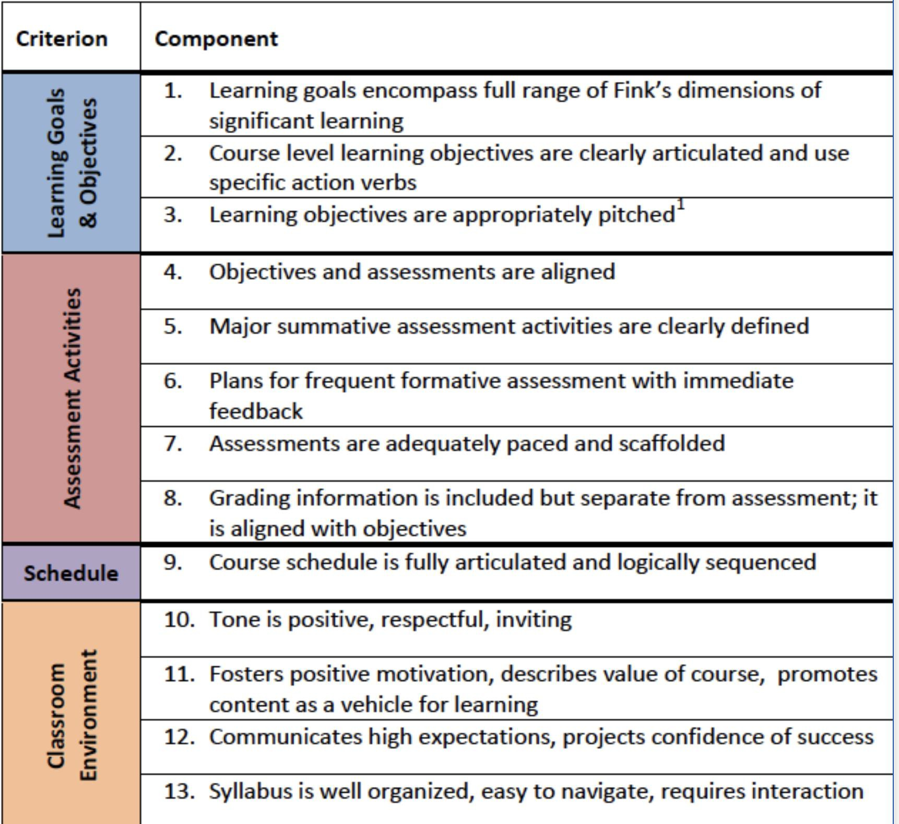
Palmer et al. 2014
Syllabus components are designated as essential, important, and less important
Components rated based on evidence found across the syllabus
Used sample syllabi to normalize ratings
Necessary prior knowledge includes Fink’s Taxonomy of Significant Learning (2013).
Notes:
1, 2, 4, 9 are essential, so they are given 3 points each
5, 10, 11 are important and are awarded 2 points each
6, 7, 8, 12, 13 are less important and are awarded 1 point each
3 is not scored but is included for completeness
FINK: Repackaging and expanding on Bloom's Taxonomy, Fink's Taxonomy of Significant Learning identifies “six kinds of significant learning” (Foundational Knowledge, Application, Integration, Human Dimension, Caring, and Learning How to Learn) and organizes them in a nonhierarchical fashion. Each of these six broad categories encompasses many types of modes of thought, skills, and intellectual and affective processes that reinforce each other and contribute to learning. Syllabi that score highly on the rubric achieve all six kinds of significant learning in Fink's taxonomy.

Slide 12
Consider your own syllabi
What might be difficult or discouraging for students? Why?
How could you make your syllabus more learning-centered and inclusive using this rubric?
Notes:
If short on time, focus on Classroom Environment components

Slide 13
Before using the rubric
After using the rubric

Slide 14
What does your score mean?
Next Steps
0-16: content-focused syllabus
17-30: transitional
31-46: learning-focused
Identify 3 things you can do to your own syllabi to increase your score towards learning-focused
Notes:
In a content-focused syllabus, the instructor emphasizes what the student will and will not do and how the instructor will reward or punish student behaviors
A learning-focused syllabus highlights the big ideas or questions in the course, describes how students will prepare to engage with these ideas or questions, and provides information about where the instructor will look to see evidence of learning success.

Slide 15
Other syllabus features to consider
Explain what students can expect from you
For example, how soon will assignments be graded?
What will you do to support your students?
Define all terms/jargon phrases like “office hours”
Use 12-14 point, sans serif fonts for better reading comprehension and to support dyslexic students
Add Table of Contents and Header text with links to other parts of the document
Use check boxes when listing student assignments
Add alt text to images and tables. Check document for accessibility

Slide 16
Thank you!
UF’s Center for Teaching Excellence
Justin Hoshaw
DEI Working Group (Drs. Bryan Dewsbury, Liz Harrison, Kristin Jenkins)
IGELS (NSF-DUE #2126154)
Gabriela Hamerlinck
ghamerlinck@ufl.edu
@gabertdoo

Slide 17
Al-Azawei, A., Serenelli, F., & Lundqvist, K. (2016). Universal Design for Learning (UDL): A content analysis of peer reviewed journals from 2012 to 2015. Journal of the Scholarship of Teaching and Learning, 16(3), 39-56.
Bowman, N. A. (2010). College Diversity Experiences and Cognitive Development: A Meta-Analysis. Review of Educational Research, 80(1), 4–33. https://doi.org/10.3102/0034654309352495
Bowman, N.A., Brandenberger, J.W., Hill, P.L., & Lapsley, D.K. (2011). The Long-Term Effects of College Diversity Experiences: Well-Being and Social Concerns 13 Years After Graduation. Journal of College Student Development 52(6), 729-239. doi:10.1353/csd.2011.0075.
Briody, E. K., Wirtz, E., Goldenstein, A., & Berger, E. J. (2019). Breaking the tyranny of office hours: Overcoming professor avoidance. European Journal of Engineering Education, 44(5), 666-687.
Capp, M. J. (2017). The effectiveness of universal design for learning: A meta-analysis of literature between 2013 and 2016. International Journal of Inclusive Education, 21(8), 791-807.
Cunningham, S. (2013). Teaching a diverse student body–a proposed tool for lecturers to self-evaluate their approach to inclusive teaching. Practice and Evidence of the Scholarship of Teaching and Learning in Higher Education, 8(1), 3-27.
Fink, L. (2003) Designing significant learning experiences. San Francisco: Jossey-Bass.
Fosslien, L., & Duffy, M. W. (2019). No hard feelings: The secret power of embracing emotions at work. Penguin.
Grunert, J. (1997) “ The Course Syllabus: A Learning-Centered Approach.” Boston, MA: Anker.
Gurin, P., Dey, E., Hurtado, S., & Gurin, G. (2002). Diversity and higher education: Theory and impact on educational outcomes. Harvard educational review, 72(3), 330-367.
https://ctl.columbia.edu/resources-and-technology/resources/inclusive-teaching-guide/
Makoelle, T. (2014). Pedagogy of inclusion: A quest for inclusive teaching and learning.
Palmer, M. S., Bach, D. J., & Streifer, A. C. (2014). Measuring the promise: A learning‐focused syllabus rubric. To improve the academy: A journal of educational development, 33 (1), 14-36.
Palmer, M. S., Streifer, A. C., & Duncun, S. (2016). Systematic assessment of high impact course design institute. To Improve the Academy, 35(2), 339-361. http://dx.doi.org/10.1002/tia2.20041
Stanberry, K. (2022). OER textbooks: A helpful tool for DEI initiatives in higher education. Journal of Higher Education Theory and Practice, 22(8), 33-36.
Tanner, K. D. (2013). Structure matters: twenty-one teaching strategies to promote student engagement and cultivate classroom equity. CBE—Life Sciences Education, 12(3), 322-331.
Virtue, E. E. (2021). Pedagogical Reflection: Demonstrating the Value of Introspection. Journal of Effective Teaching in Higher Education, 4(1), 128-142.
Weimer, M. (2013). Learner-centered teaching: Five key changes to practice. (2nd ed.). San Francisco: Jossey- Bass.
References and Resources

Slide 18
Optional supplementary rubric and scoring
To help assess the quality of individual classroom activities
Scoring if you used the supplemental rubric,
0-18: content-focused
19-40: transitional
41-58: learning-focused

