Slide 1
Sustainable Development Goals in the Classroom and Beyond
University of Florida SDG Faculty Guide
Interface 2023 Workshop
Natalie Coers, PhD
Agricultural Education & Communication
Ryan Good, PhD
School of Natural Resources and Environment

Slide 2
Workshop Objectives
Create awareness of available tools to increase awareness of the SDGs;
Provide opportunities to experience how such tools could be used in a classroom setting; and
Engage in discussion regarding effective practices of SDG tools.

Slide 3
SDG Context Check
On a scale of 1 – 5, how familiar are you with the SDGs?
1 = SDGs – huh?
2 = Heard of them but not familiar
3 = Basic Understanding
4 = Solid Understanding
5 = Currently use SDGs in my classroom/research/programming

Slide 4
Sustainable Development Goals
Purpose: Develop awareness of issues facing our world and the actions being taken to create solutions within and between countries.
17 Sustainable Development Goals → 169 SDG Targets → 232 Unique Indicators.

Slide 5
SDG Perspectives & Priorities
One SDG per box.
There is no “right” answer.
The column (up & down matters) the placement in the column does not.
Least Important SDG
Most Important SDG

Slide 6
At Your Table…
What factors influenced your group’s decision of the most & least important SDG?
How is your layout similar or different from the other at your table? Another table?

Slide 7
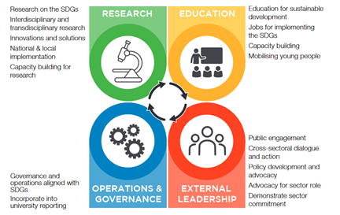
University Contributions to the SDGs
https://www.unsdsn.org/accelerating-education-for-the-sdgs-in-univerisities

Slide 8
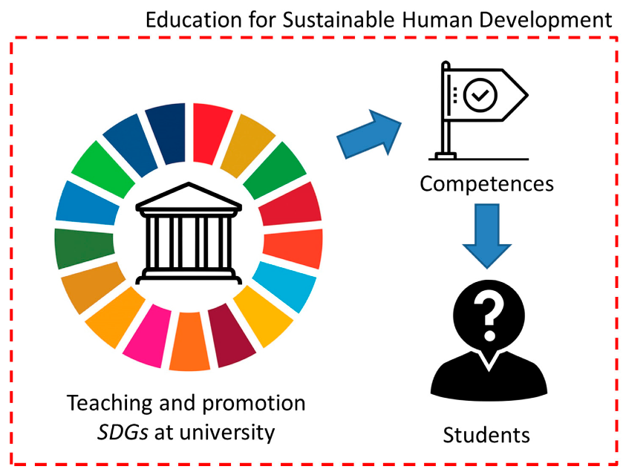
https://www.unsdsn.org/accelerating-education-for-the-sdgs-in-univerisities

Slide 9
"Universities, through their extensive research capabilities and activities, have a critical role in providing the necessary knowledge, evidence-base, solutions and innovations to underpin and support this task."
Sustainable Development Solutions Network Australia/Pacific (2017) Getting started with the SDGs in universities: A guide for universities, higher education institutions, and the academic sector

Slide 10
Worldview Upgrader
Notes:
Activity – if large enough group, each person = a country; if smaller group, card sets for groups of 2-3

Slide 11
activity
In your groups or table, select one person to be the quiz operator.
Work through as many of the questions as possible within the allocated time.

Slide 12
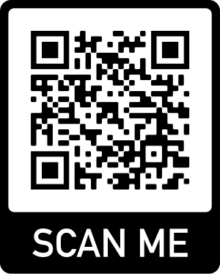
Quiz time… Misconception Studies - 2020
Notes:
Gapminder SDG Quiz – sele
Rosling family
Gapminder is an independent Swedish foundation with no political, religious or economic affiliations.
Gapminder is a fact tank, not a think tank.
Gapminder fights devastating misconceptions about global development.
Gapminder produces free teaching resources making the world understandable based on reliable statistics. Gapminder promotes a fact-based worldview everyone can understand.
Gapminder collaborates with universities, UN, public agencies and non-governmental organizations.
ct your respective SDG and take the quiz…

Slide 13
Discussion
What surprised you the most from the quiz?
How many correct answers did your group get?
Where do some of these misperceptions stem from today?
How can we counter these misperceptions?

Slide 14
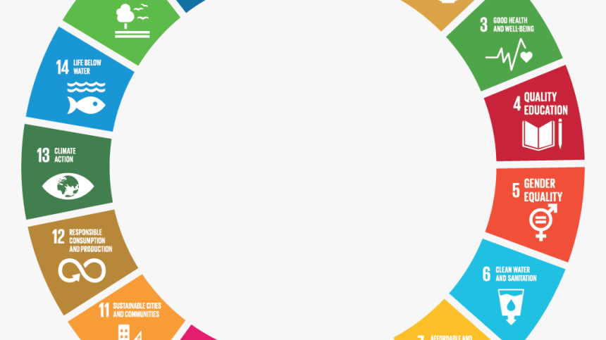
WHAT NEXT?

Slide 15
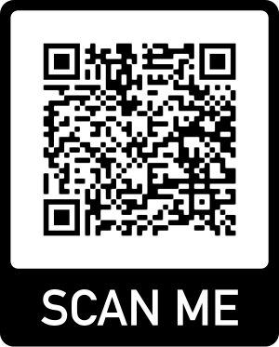
UF SDG Faculty Guide
Join our Faculty Learning Community…

Slide 16
Workshop Objectives
Create awareness of available tools to increase awareness of the SDGs;
Provide opportunities to experience how such tools could be used in a classroom setting; and
Engage in discussion regarding effective practices of SDG tools.

Slide 17
THANK YOU!
Natalie Coers, PhD
Agricultural Education & Communication
ncoers@ufl.edu
Ryan Good, PhD
School of Natural Resources and Environment
rgood@ufl.edu

