Slide 1
Teaching Gen Z Students
Dr. Michael Barber

Slide 2
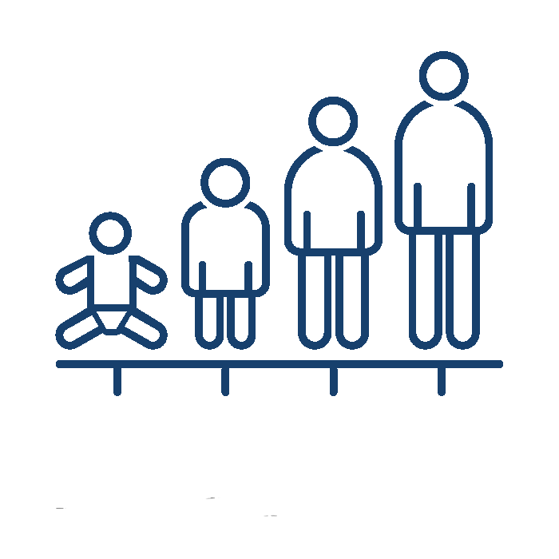
OVERVIEW
1 Framing the Presentation
2 Defining Generational Cohorts
3 Characteristics of Gen Z Students
4 Research-based Teaching Strategies

Slide 3
FRAMING THE PRESENTATION

Slide 4
FRAMING
Stereotypes and overgeneralizations
Relationships are reciprocal
Principles of teaching
Notes:
Caution about stereotyping and overgeneralizing, but realize that there are statistical trends
Not suggesting that you have to make all the changes to accommodate students, but awareness can help us better reach and teach. Relationships are reciprocal.
When we talk about teaching strategies, I will discuss principles without being too specific. You will know your discipline and how to best apply those principles in your teaching.
https://padlet.com/mebarber1970/what-you-are-noticing-about-gen-z-students-11lbzn3i36627ov3

Slide 5
DEFINING GENERATIONAL COHORTS

Slide 6
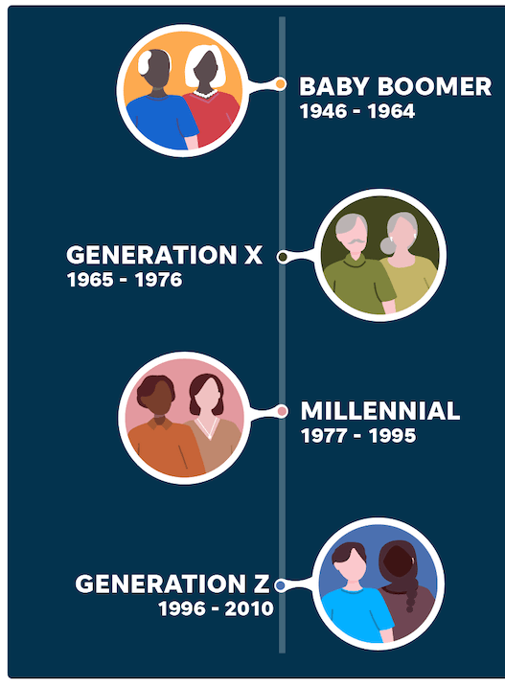
GENERATIONS

Slide 7
GENERATIONAL EXPERIENCES
Technology & Social Media
School shootings
Political polarization
Protests over police brutality
Marriage equality
(Selingo, 2018)

Slide 8
COMPARISON WITH MILLENNIALS
Millennials
Gen Z
Passive consumers
Motivated by traditional measures of success
Want directive instruction
Active consumers
Motivated by relevance and social impact
Value personalized guidance rather than general information/advising

Slide 9
CHARACTERISTICS OF GEN Z STUDENTS
Notes:
https://padlet.com/mebarber1970/what-you-are-noticing-about-gen-z-students-11lbzn3i36627ov3
https://www.facebook.com/TheHoldernessfamily/videos/1500103010517165

Slide 10
DIGITAL NATIVES
8-10 hours of screentime per day
Access to information
Social media
[Attention span, feedback, interpersonal skills, critical thinking, community]
Notes:
Information overload: wake up to phones, scroll social media to see what missed out on, information is not sacred (Google), lack ability to decipher what is true, more questioning of information than millennials
Speed/instant access to feedback: i.e., recipes for dinner, texting=shorter attention spans, lack of depth of knowledge (generalists vs. specialists), thrive on experiential/interactive learning
Multi-media—Snapchat, Google, Skype, YouTube, Tik Tok, TV, tablets, phones=gap in nontechnical skills
Results: short attention spans, expect instant feedback, lack interpersonal communication skills, lack problem-solving skills, poor time management, value peers, community, authority [different from millennials])
https://www.facebook.com/VT/videos/girl-rants-about-being-in-timeout/2849396915202132/

Slide 11
DIVERSITY
45% of undergraduates identify as people of color
Global community
Value relationships
[Inclusive of ethnicity, culture, gender]
(Universities and College Designers Association, 2021)
Notes:
45% of undergraduates identify as people of color (up 30% in two decades) [https://www.ucda.com/journal/diversity-in-higher-education/#:~:text=Set%20Clearer%2C%20More%20Complete%20Long,of%2030%25%20over%20two%20decades.]
Exposure through media to global issues, cultures
Results=inclusivity, less inhibited by biases

Slide 12
PRACTICAL
Value real-world topics
Want to see clear applications to life/career
[Questioning, guidance and mentoring]
(Selingo, 2018)
Notes:
Millennials tended to accept information more readily, but Gen Z tends to be more questioning and scrutinizing/ask for input from peers and trusted adults;

Slide 13
MENTAL HEALTH
91% report physical or emotional symptoms in past month due to stress
Increase in depression and anxiety
[Withdrawal, irritability, worried, motivation]
(American Psychological Association, 2018)
Notes:
91% report physical or emotional symptom in past month due to stress compared to 74% of adults overall
[https://www.apa.org/news/press/releases/stress/2018/stress-gen-z.pdf]

Slide 14
RESEARCH-BASED TEACHING STRATEGIES

Slide 15
TRANSPARENCY
Involve them in creating expectations
Provide rationale for assignments
Describe the task
Explain standards of evaluation
Feedback vs. criticism
Notes:
Help them think through consequences—frontal lobe development, “emerging adulthood”
Explain the “why”—history of anesthesiology example
Rubrics
Frame feedback—create culture of learning through mistakes, model appropriate reactions to mistakes
Transparency template: https://docs.google.com/document/d/1RfxP5CjShS30gv9ejRtnUYByY9ttp0m64rLyYIPnPgs/copy

Slide 16
CRITICAL THINKING
Defining and teaching
Think aloud/modeling
Asking for explanations for answers
Problem-based learning
(Harber, 2020)
Notes:
Issues with operationalizing what critical thinking is; it means different things to different people. Can be discipline specific.
knowledge (for example, knowledge of one or more logical systems)
skills (such as skills in applying that logical system to construct and analyze arguments)
dispositions (such as the willingness to apply critical-thinking principles, rather than fall back on existing unexamined beliefs, or simply believe what you’re told by authority figures)
Teaching:
Needs to be explicit and metacognitive
Deliberate practice (takes 10,000 hours to become a skilled athlete or musician)
Helpful feedback
I Search Paper example
https://docs.google.com/document/d/1j0Mh78odnI43xgI2Ewb6dh57a-i36CwMQ63aytQDpLk/copy

Slide 17
EXPERIENTIAL LEARNING
80% prefer collaborative learning
Be a “guide on the side”
Use hands-on activities
Whole-class feedback/peer review
Embrace technology
(Barnes and Noble College, 2018)
Notes:
Guide on the side: don’t want you to do a lecture on the four theories of leadership that I can read about in 10 minutes on my phone; want to come to class and apply the theories
Embrace technology: Simply adding technology to a course is not enough. We must take command of it to produce customized, fun, and interactive learning experiences. Use it to develop relationships.
Michael Wesch video

Slide 18
FLIPPED CLASSROOM

Slide 19
INCLUSIVITY
Explore your culture and biases
Understand other cultures
Represent diversity
Be sensitive to mental health
Build relationships, trust, and community

Slide 20
MODULAR CLASSROOM
(Lang, 2020)
Notes:
James Lang: Distracted

Slide 21
MODULAR CLASSROOM
(Lang, 2020)
Notes:
Varying lecture learning with active learning to help attention span. Post it note list of activities that can be woven into class period to reinforce principles and provide practice.

Slide 22
THANK YOU!
American Psychological Association (2018). Stress in America: Generation Z. Stress in America™ Survey.
Barnes and Noble College. (2018). Getting to know Gen Z: Exploring middle and high schoolers’ expectations for higher education. https://www.bncollege.com/wp-content/uploads/2018/09/Gen-Z-Report.pdf
The Best Generation Years Chart & Names List. (2022, July 12). eDigital Agency. Retrieved July 21, 2022, from https://www.edigitalagency.com.au/market-research/best-generation-years-chart-names-list/

Slide 23
SOURCES
Harber, J. (2020). It’s time to get serious about critical thinking. Inside Higher Ed. Retrieved October 21, 2022 from https://www.insidehighered.com/views/2020/03/02/teaching-students-think-critically-opinion.
Lang, J. M. (2020). Distracted: Why Students Can’t Focus and What You Can Do About It. Basic Books.
Selingo, J. (2018). The new generation of students: How colleges can recruit, teach, and serve gen z. The Chronicle of Higher Education.

Slide 24
SOURCES
University and College Designers Association. (2021). Diversity in Higher Education: Statistics, Gaps, and Resources - 08–06-2021 : UCDA contact: Courtesy of Bradley University. https://www.ucda.com/journal/diversity-in-higher-education/
University of Massachusetts Global. (2020, May 4). 3 Generation Z traits today’s teachers need to adapt to. Umassglobal.Edu. Retrieved June 14, 2022, from https://www.umassglobal.edu/news-and-events/blog/generation-z-traits-teachers-need-to-adapt-to
Icons from TheNounProject.com; Pictures from UF Photography: https://ufphotography.photoshelter.com/index (photo on introductory slide is a stock PowerPoint photo from the template).

Slide 25
SIMILARITIES WITH MILLENNIALS
Information overload
Speed & instant access
Multi-media
Notes:
Information overload: wake up to phones, scroll social media to see what missed out on, information is not sacred (Google), lack ability to decipher what is true
Speed/instant access to feedback: i.e., recipes for dinner, texting=shorter attention spans, lack of depth of knowledge (generalists vs. specialists), thrive on experiential/interactive learning
Multi-media—Snapchat, Google, Skype, YouTube, Tik Tok, TV, tablets, phones=gap in nontechnical skills (problem-solving, time management, interpersonal communication, critical thinking), diversified and experiential learning, peers and community

Slide 26
UF COLLEGE OF DENTISTRY

