Slide 1
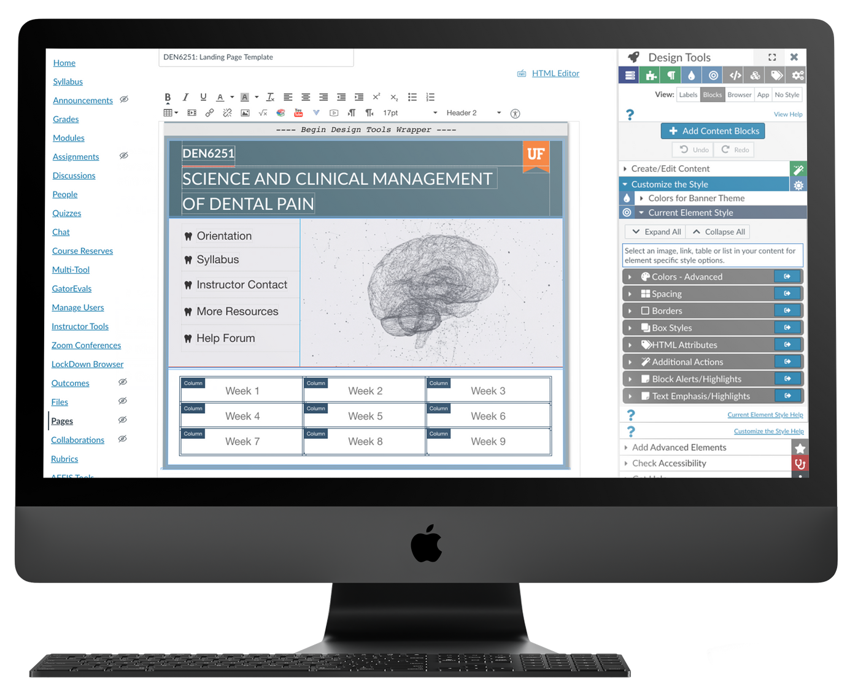


DesignPLUS
Create Your Framework for Learning with Design Tools

Slide 2
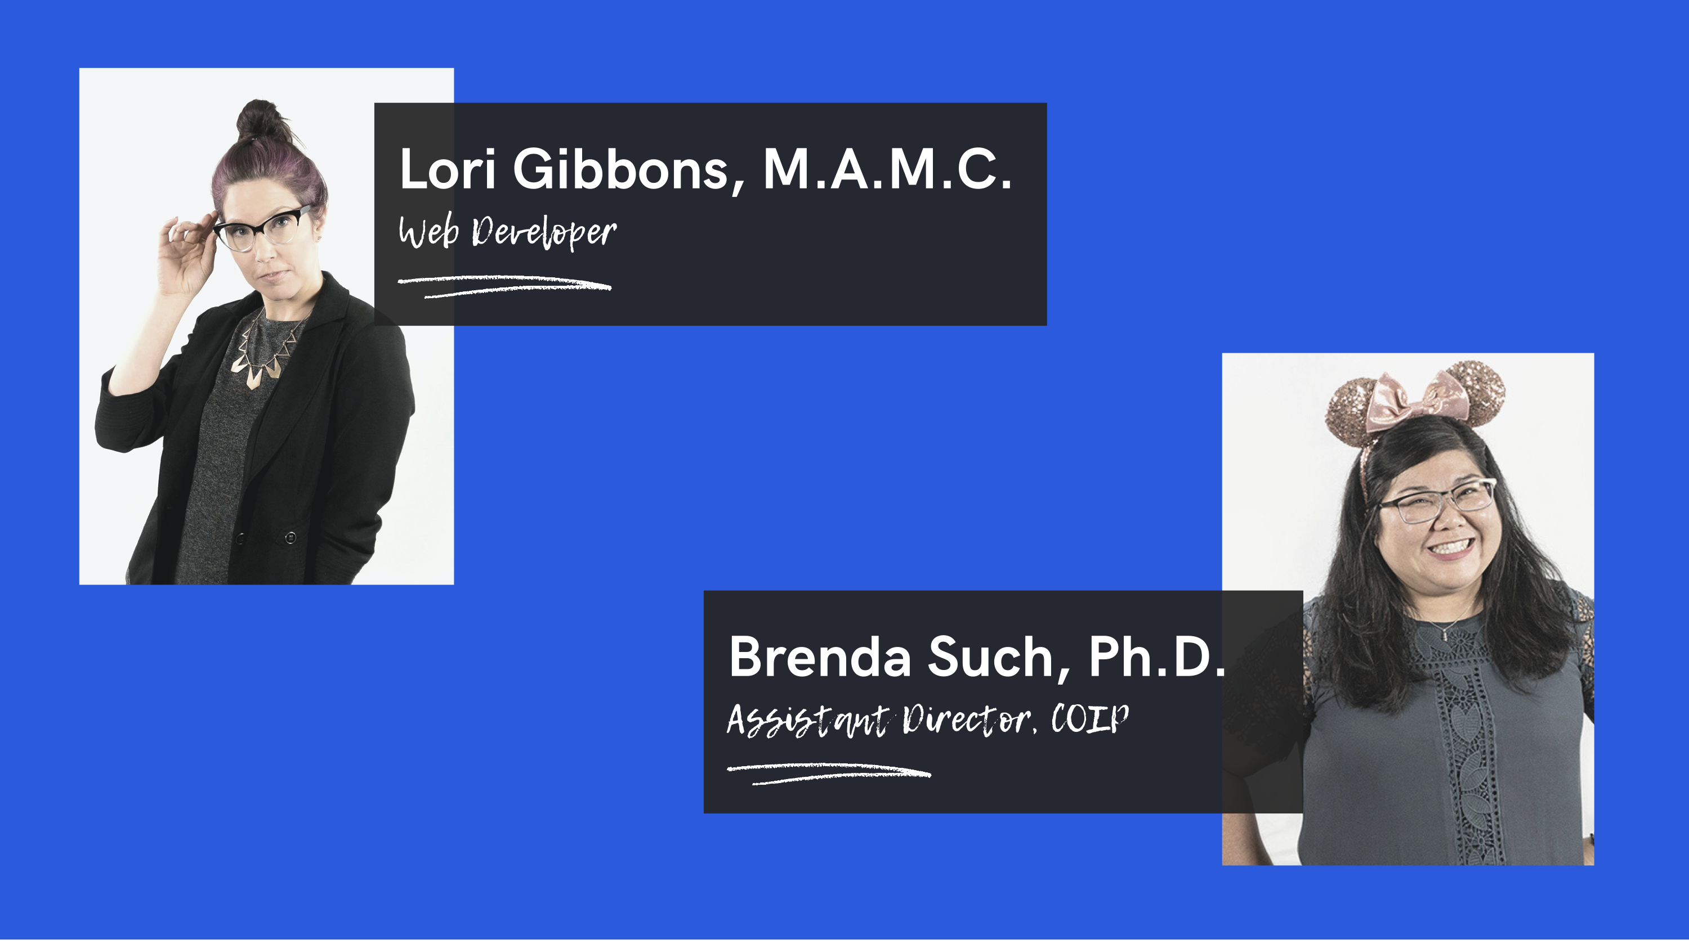
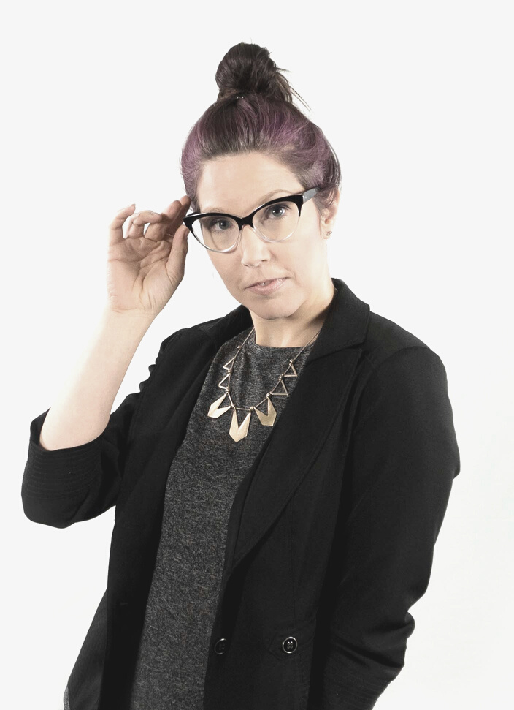
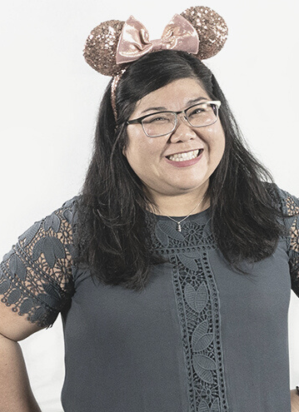
Lori Gibbons, M.A.M.C.
Web Developer
Brenda Such, Ph.D.
Assistant Director, COIP

Slide 3

Workshop Outline
Key topics for discussion
Introduction
Why Design Tools?
Design Tools for Faculty and Staff Course
How to Add Content with Design Tools
Demonstration with Examples
Q&A
Conclusion

Slide 4
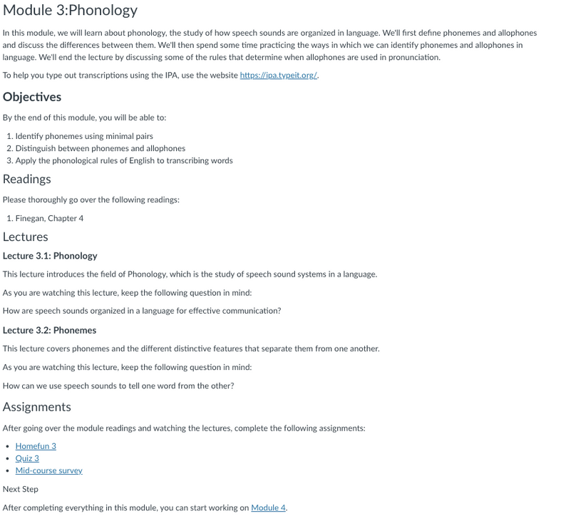
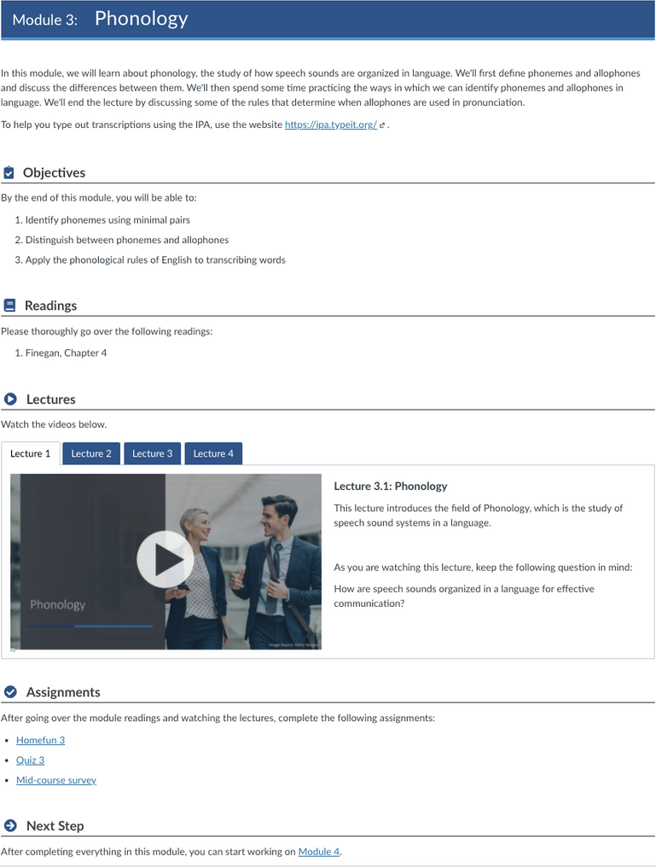
Before
After

Slide 5
Build courses in minutes
Reuse and update existing content
(not hours)
Easily copy content and use themes and templates to style pages faster
Design courses with accessible content
Improve student experience
Built-in accessibility tools at your fingertips
Improve the quality, consistency and accessibility of your courses

Slide 6

Where to Go for Design Tools Training
UF-targeted training
DesignTools Resources for Faculty and Staff
Canvas Course Link:
https://ufl.instructure.com/courses/414975

Slide 7
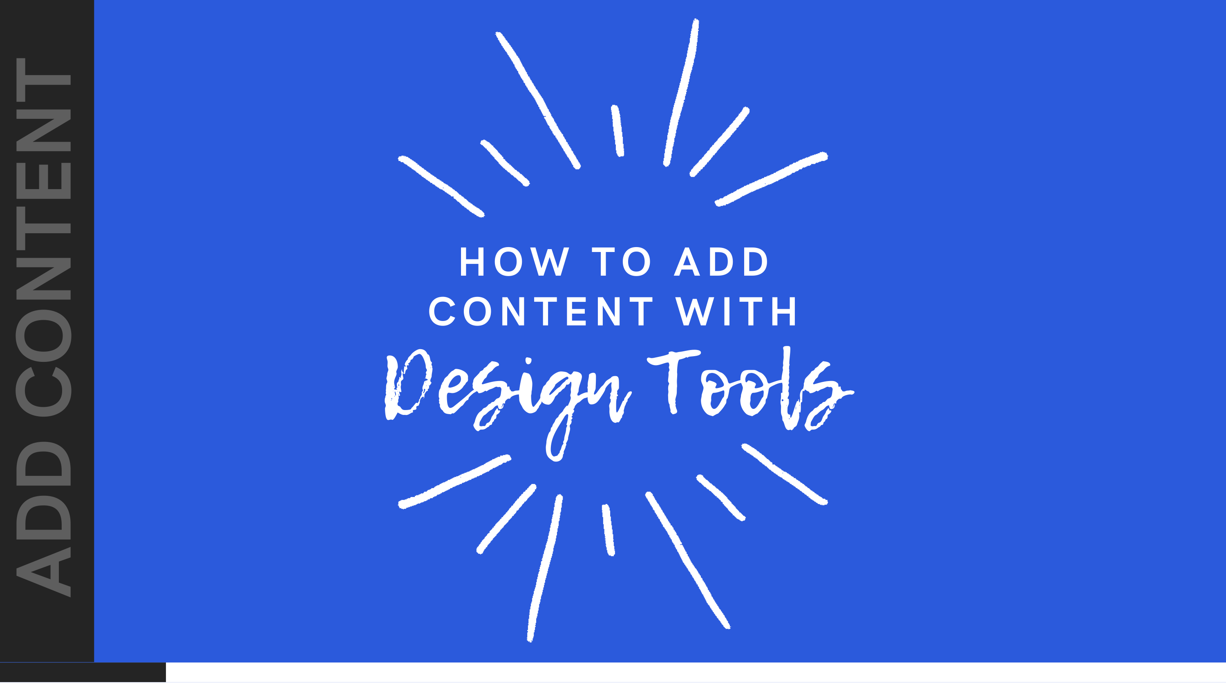
HOW TO ADD CONTENT WITH
ADD CONTENT
Design Tools

Slide 8

DEMONSTRATION WITH
HANDS-ON ACTIVITY
Examples

Slide 9
THANK YOU!
Email us with any questions or modification requests!
Website
Email Address
coip.aa.ufl.edu
coip@mail.ufl.edu

