Slide 1
Peer Led Formative Assessment

Slide 2
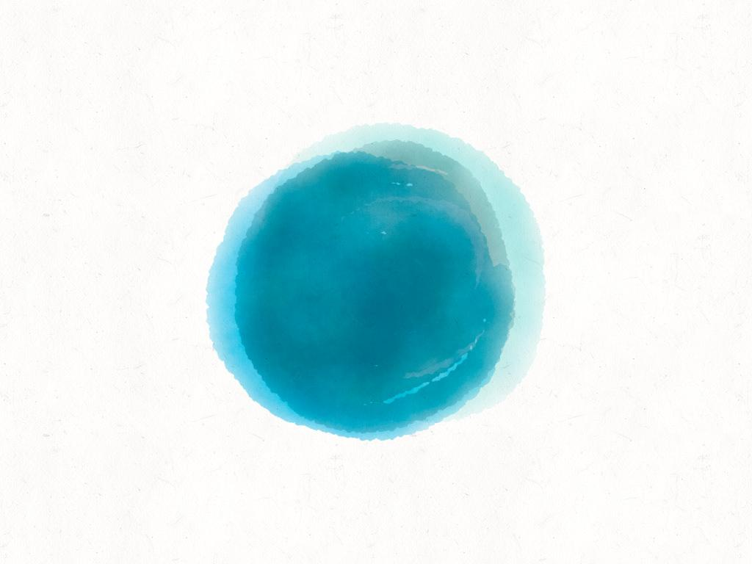
hello!
Ann Harding
MME
PK Yonge

Slide 3
1.
Begin With the End in Mind

Slide 4
Begin With the End in Mind
What skill do we want our students to show mastery?
What real life skill does our content relate to?
Set a preference towards real and authentic performance based assessment
Notes:
Sometimes this is easy, sometimes it isn’t.
Think about how your content translates into the real world. What would it look like to use this information on the job or in the field. Can your assessment give them something that they can use in the future?

Slide 5
“We learn:
20% of what we READ
30% of what we HEAR
40% of what we SEE
50% of what we both SEE and HEAR
70% of what we DISCUSS with others
80% of what we EXPERIENCE personally
90% of what we TEACH others.”
Audrey Gartner, 1998

Slide 6
Setting the Stage for Peer Based Assessments
Support positive peer interactions by explicitly stating expectations. (Don’t take things personally, everyone is here to learn, learning is not a competition)
Ensure everyone has the potential to be called on
Model positive constructive feedback, and then step into the role of facilitator
Use get to know you activities. They don’t have to be lame!

Slide 7
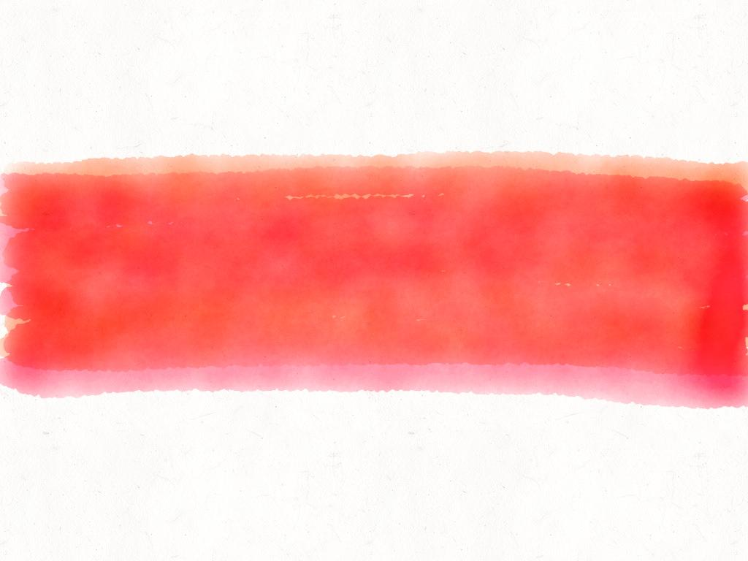
Use Peer Groups

Slide 8
Develop Rubrics For Assessment
Clear expectations are key
Students can assess
One on one
Small group
Whole group
Peers to assess product or performance
(the successful students are doing this on their own in study groups. Making it a part of your class will help students who struggle to make those connections outside of class)
Notes:
Without rubrics, students feel like they are guessing at expectations.

Slide 9
Benefits
Less Grading For You
More Authentic Learning Experiences
More Frequent Feedback for Students
Notes:
Also provides real world experience when rooted in practice

Slide 10
What this looks like in my classroom
Daily Battles
Present students with new concept
2 minutes to practice
2 students battle
Students self assess
Peers assess as support
Peer Evaluations
Formative Assessment
Check ins with peer
Group work
One student evaluates whole group
Formal Peer Reviews
Summative Assessments
Students evaluate each other
Gives quicker feedback

Slide 11
Thanks!
any
questions
?
You can find me at
@username / user@mail.me

Slide 12
Credits
Special thanks to all the people who made and released these awesome resources for free:
Presentation template by SlidesCarnival
Photographs by Unsplash
Paper backgrounds by SubtlePatterns

