Slide 1
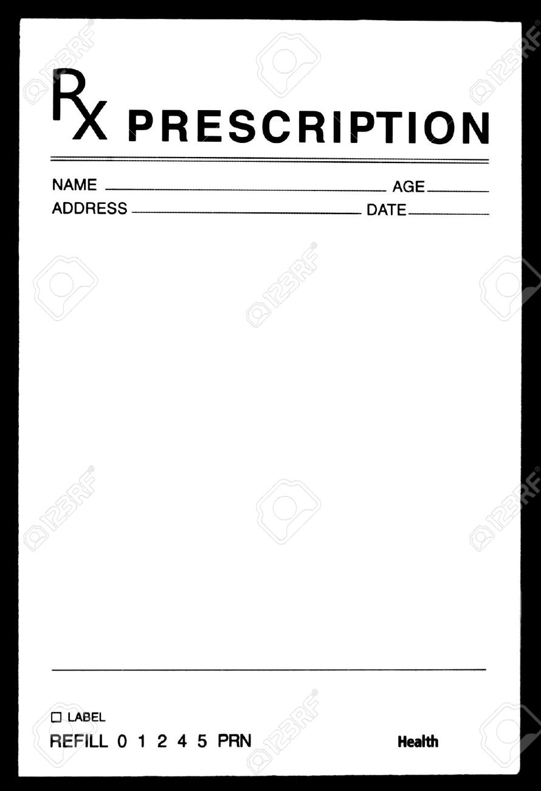
Collaborative learning teams + A dose of intention Teamwork skill development
Teamwork Skills
Use daily as needed
Priti Patel, PharmD, BCPS
Stacy Miller, PharmD, MBA, BCACP

Slide 2
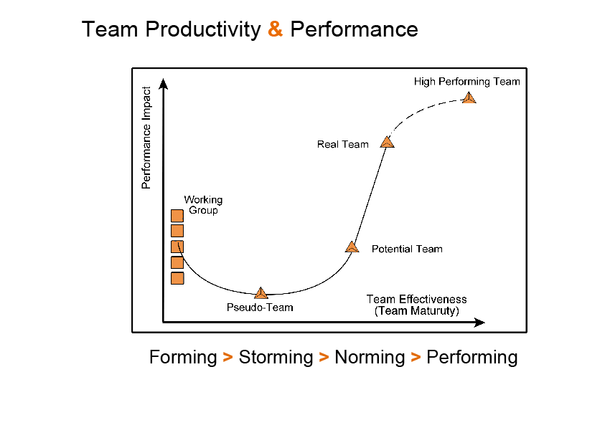
Team Development & the Team Performance Curve
Katzenbach & Smith’s Team Performance Curve. The Wisdom of Teams: Creating the High-Performance Organization. Harvard Business Review Press. 1993.
Tuckman’s Stages of Team Development
http://www.teamperformancegroup.com/TeamFormations.html
Notes:
Notes below are from: https://www.praxisframework.org/en/library/katzenbach-and-smith Blend between Tuckman’s stages and the Team Performance Curve (Katzenbach & Smith)
Working group
The team members come together to share information but as yet there is no common purpose or performance goals that require mutual accountability. Each team member is only accountable for the work that the group has delegated to them.
Pseudo team
This team is at the bottom of the performance curve. Members may believe they are part of a team but not yet acting like one. This may be because they don’t want to take the risk of committing to a common purpose and the mutual accountability that this entails.
Potential team At this level the team members are moving towards a common goal and approach to achieving it. They are working towards a higher level of performance and must agree on mutual accountability.
Real team In this type of team a small group of people share a common purpose and approach. They have complementary skills and share accountability for results.
High performing team The difference between a real team and a high performing team is the relationships between the team members. High performance results from the members being committed to one another’s personal growth and development.
See also: https://www.praxisframework.org/en/library/katzenbach-and-smith
Forming
The main difference between a random group of people and a team is the team’s common objective. When individuals are first brought together they do not have a common objective. They may be anxious about why they have been brought into this team; they will be hesitant about their new environment, unsure of what they have in common with other team members and confused as to the purpose of the project or programme.
Typically, the individuals will indulge in some superficial questioning of colleagues to look for more information, common ground and possible allegiances.
Storming Different types of individual will behave in very different ways during the forming stage. This will start to bring about conflict between individuals or small sub-groups within the team. The more assertive individuals will try to impose some order by defining rules. This could result in leadership being challenged whilst a ‘pecking order’ is established.
Assuming a common purpose has been identified, very different views will arise as to how that purpose should be achieved.
Norming
As the issues and conflicts of the storming stage are resolved, the team starts to settle down and concentrate on tasks and issues rather than personalities. An acceptance of common values and behaviours develops with open communication that promotes constructive review and suggestions for alternatives.
The team is starting to become a cohesive unit, truly working as a team with its capabilities being greater than the sum of its parts.
Performing
By this stage the team is working as a focused unit. There is collaboration between team members to solve problems with a visible change in mentality from “me” to “we”. There is a shared responsibility for the common goal and individuals are confident enough to innovate and provide insights into problems, which arise.
Individuals demonstrate flexibility, with job titles becoming transparent and delegation of authority working efficiently.
Adjourning
This is the stage that comes as the project or programme commences the closing a project or programme process and demobilisation is near. Some team member’s thoughts may turn to life after the project and therefore they pay less attention to the work in hand.
This could be a dangerous time for the manager who is focused on a rapidly approaching deadline and stakeholders who are suddenly more motivated to get involved as the point of handover approaches.
Life for team members after the project or programme is out of the manager’s control but the team member’s performance is affected by it. It must therefore be in the manager’s interests to at least work with the team member to allay their concerns.
Mourning
The final stage is possibly mourning. Although there are going to be some projects and programmes that some team members can’t wait to get away from, where the project has been managed well and a team member has worked hard to produce a great result, there will inevitably be a sense of loss.
The mourning stage is not so much a problem at the end of the project or programme because it comes after the closure. Its main effect is on the manager of the next piece of work who has to get a group of people together and form a new team, some of whom are mourning the passing of the last team. And so we come full circle.
The best approach to motivating these team members is to find out what was good and bad about the last project or programme and encourage them to use their experience to make the current one better.

Slide 3
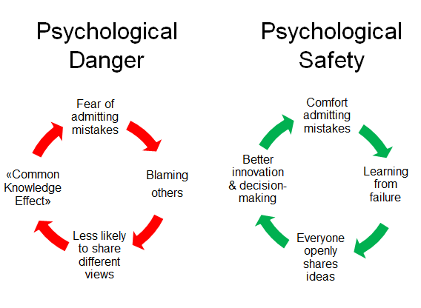
Psychological Safety
“A shared belief that the team is safe for interpersonal risk taking.”
Edmondson A. The fearless organization: creating psychological safety in the workplace for learning, innovation, and growth. Wiley, 2018.
https://www.weforum.org/agenda/2016/04/team-psychological-danger-work-performance/
Notes:
Trust: will YOU give others the benefit of the doubt when you take a risk?
Psych safety: will OTHERS give you the benefit of the doubt when you take a risk?

Slide 4
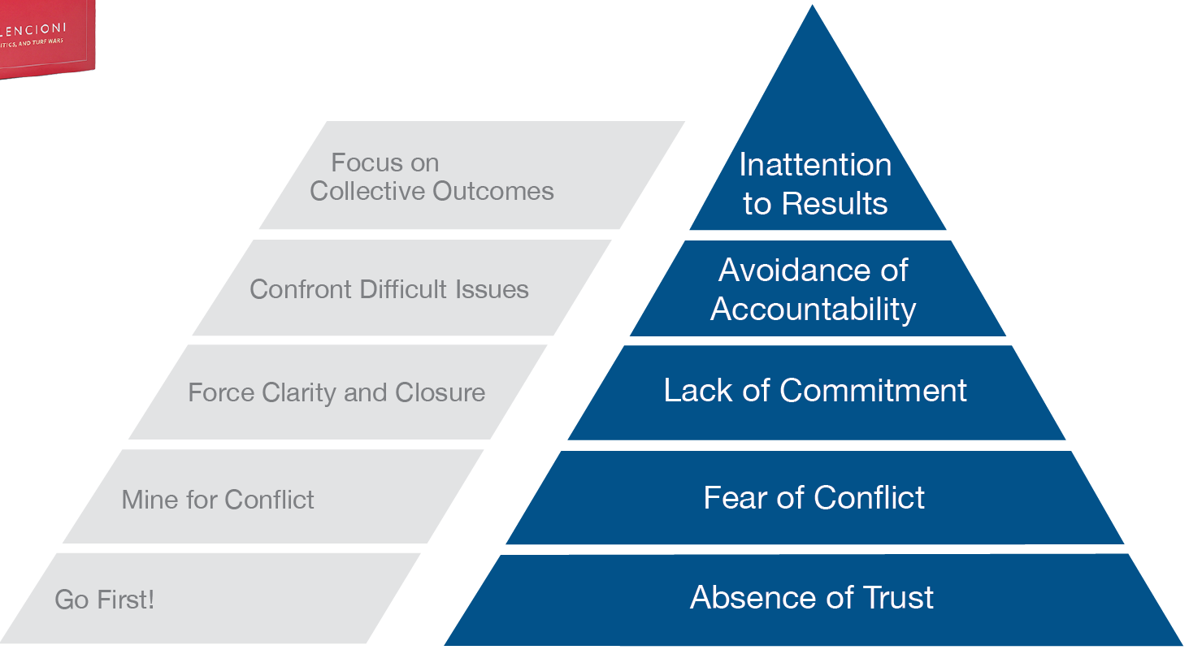
The Five Dysfunctions of a Team
Patrick Lencioni. Jossey-Bass, 2002.

Slide 5
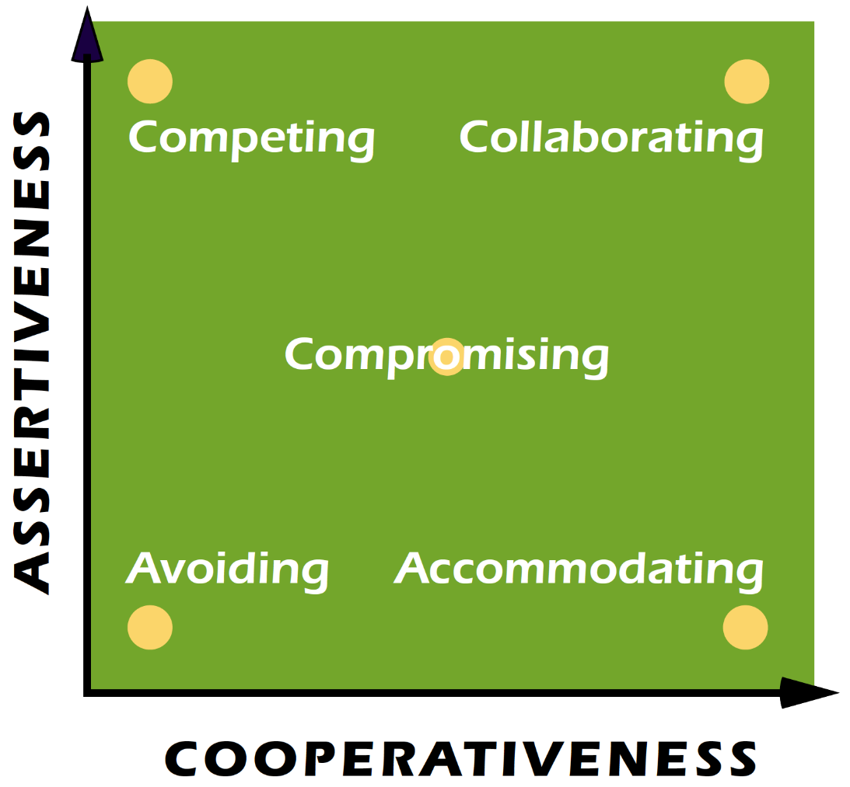
Conflict Modes
Thomas-Kilmann Conflict Mode Instrument. Available at: https://www.kilmanndiagnostics.com/overview-thomas-kilmann-conflict-mode-instrument-tki
Notes:
These two basic dimensions of behavior define five different modes for responding to conflict situations:
Competing is assertive and uncooperative—an individual pursues his own concerns at the other person's expense. This is a power-oriented mode in which you use whatever power seems appropriate to win your own position—your ability to argue, your rank, or economic sanctions. Competing means "standing up for your rights," defending a position which you believe is correct, or simply trying to win.
Accommodating is unassertive and cooperative—the complete opposite of competing. When accommodating, the individual neglects his own concerns to satisfy the concerns of the other person; there is an element of self-sacrifice in this mode. Accommodating might take the form of selfless generosity or charity, obeying another person's order when you would prefer not to, or yielding to another's point of view.
Avoiding is unassertive and uncooperative—the person neither pursues his own concerns nor those of the other individual. Thus he does not deal with the conflict. Avoiding might take the form of diplomatically sidestepping an issue, postponing an issue until a better time, or simply withdrawing from a threatening situation.
Collaborating is both assertive and cooperative—the complete opposite of avoiding. Collaborating involves an attempt to work with others to find some solution that fully satisfies their concerns. It means digging into an issue to pinpoint the underlying needs and wants of the two individuals. Collaborating between two persons might take the form of exploring a disagreement to learn from each other's insights or trying to find a creative solution to an interpersonal problem.
Compromising is moderate in both assertiveness and cooperativeness. The objective is to find some expedient, mutually acceptable solution that partially satisfies both parties. It falls intermediate between competing and accommodating. Compromising gives up more than competing but less than accommodating. Likewise, it addresses an issue more directly than avoiding, but does not explore it in as much depth as collaborating. In some situations, compromising might mean splitting the difference between the two positions, exchanging concessions, or seeking a quick middle-ground solution.
Each of us is capable of using all five conflict-handling modes. None of us can be characterized as having a single style of dealing with conflict. But certain people use some modes better than others and, therefore, tend to rely on those modes more heavily than others—whether because of temperament or practice.
Your conflict behavior in the workplace is therefore a result of both your personal predispositions and the requirements of the situation in which you find yourself. The TKI is designed to measure this mix of conflict-handling modes.

Slide 6
UF College of Pharmacy
Doctor of Pharmacy Program
4 years
3 years didactic
1 year experiential
Team-Based Learning curriculum

Slide 7
UF COP Techniques to Encourage Successful Team Skill Development
Team debriefings with self- and team- reflection
Faculty-assigned teams
Team contract
Targeted faculty coaching
Peer & team evaluations

Slide 8
End of Spring Semester
Fall semester
Spring semester
Formative Peer Evaluation
Mini-reflection
Team Debriefing
Targeted Faculty coaching
Summative Peer Evaluation
End of Fall
Semester
Orientation
Team membership announced
Create team contract
Formative Peer Evaluation
Mini-reflection Team Debriefing
Targeted Faculty coaching
Formative Peer Evaluation
Mini-reflection
Team Debriefing
Targeted Faculty coaching
Mid-Spring
Semester
Mid-Fall
Semester
Notes:
Teams remain together for the duration of the academic year across all courses. Content delivered via online lectures/readings and in-class active learning modules where a variety of collaborative learning approaches are used including TBL. Students working in teams during classes for about 8-12 hrs/week.
Debrief #1: Discuss individual reflection with team and obtain input on what you need to focus on. Team must agree to the behavior changes expected of each member. Revisit the team contract to reflect or revise.
Debrief #2: Discuss how team members were supported to make their behavior changes; Discuss individual reflection with team and obtain input – team agrees on behavior changes expected of each member. Revisit team contract if needed.
Debrief #3: Discuss how team members were supported, discuss individual reflection with team and obtain input – team agrees on behavior changes expected of each member. Identify behaviors each member should bring to their next team. Revisit team contract if needed.

Slide 9
Small Group/Table Activities

Slide 10
Congratulations! You’ve implemented a collaborative learning method in your classroom. You want to demonstrate students are more effective team members at the end of the course. Which method will you use? Select one.
Team Contract
Team Debriefings
Peer Evaluation
Team Evaluation
Targeted Faculty Coaching (Individuals & Teams)
Notes:
8 min intra-team discussion/7-minute inter-team discussion

Slide 11
You are utilizing team-based learning in your classroom. You tell teams to discuss a question you give them. You see a team that looks like this:
Chung: texting on his phone and occasionally listening to teammates
Mala: discussing the question out loud
Javier: listening to Mala but not saying much
Nisha: shopping on her laptop
William: scrolling through his notes looking for the answer

Slide 12
In the short-term, what will be the most effective intervention for you to do to assist this team in improving team dynamics?
Do nothing immediately, and rely on the peer evaluation later this semester.
Encourage the team to engage in team building (e.g. bring food, happy hour etc).
Encourage students to organize a team meeting.
Faculty organizes a team meeting.
Faculty meets 1-on-1 with select team members.
Notes:
View video 3 min/7 min intra-team discussion/5 min inter-team discussion

Slide 13
UF College of Pharmacy Team Learning Summary
Assigned by faculty
Same teams for entire academic year through all required courses
Collaborative learning teams + Dose(s) of intention Teamwork skill development
Teamwork theories
Team-Based Learning methods

Slide 14
Collaborative learning teams + A dose of intention Teamwork skill development
Teamwork Skills
Use daily as needed
Priti Patel, PharmD, BCPS
Stacy Miller, PharmD, MBA, BCACP

