Slide 1
Interface Teaching Conference, April 2021
Global Learning Gaps? First Tell Me Who You Are
The Impact of Ethnicity and Gender
Timothy Brophy, Mary Kay Carodine & Paloma Rodriguez
University of Florida

Slide 2
The Survey Instrument

Slide 3
Survey
Learning without Borders: Internationalizing the Gator Nation
Leadership team
Leo Villalon, Dean, International Center
Paloma Rodriguez, Director, Office of Global Learning
Mary Kay Carodine, Assistant Vice President, Student Affairs
Timothy S. Brophy, Professor and Director, Institutional Assessment
Matthew Jacobs, Director, Bob Graham Center
UF’s Quality Enhancement Plan
A SACSCOC Accreditation requirement
Internationalization Task Force – 2010-2013

Slide 4
Survey
International Critical Thinking (IntCRIT) and International Communication (IntCOMM) Attitudes and Beliefs Survey
We reviewed all commercially available measures
Created our own, with Tim Wilson, a PhD candidate in Research and Evaluation Methodology (guided by M. David Miller)
Wilson, Timothy J. (2014). Assessing internationalization efforts: Utilizing Item Response Theory to validate intercultural competency and global awareness in postsecondary undergraduate students. (doctoral dissertation, University of Florida). Retrieved from: http://eds.b.ebscohost.com/eds/detail/detail?vid=1&sid=1563ae9d-bb48-458b-ae5d-a59011c14e08%40pdc-v-sessmgr04&bdata=JkF1dGhUeXBlPWlwLHVpZCZzaXRlPWVkcy1saXZl#AN=ufl.033650760&db=cat04364a

Slide 5
FINDINGS

Slide 6
SURVEY RESULTS
Results by Component
Communication
UF IntCRIT & IntCOMM Attitudes and Beliefs Survey

Slide 7
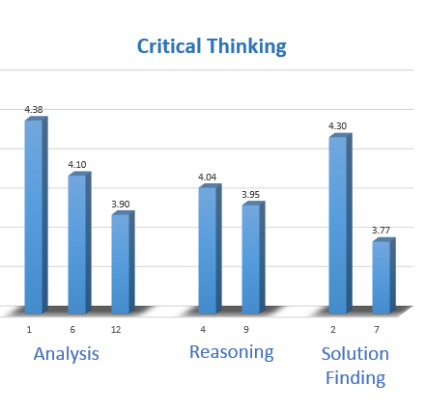
SURVEY RESULTS
Critical Thinking Lowest Scored Items
11. Knowing about other cultural beliefs is important
HIGHEST
5. Knowing about other cultural norms and beliefs is important to me
9. I can recognize how different cultures solve problems
12. I am able to recognize how members of other cultures make decisions
LOWEST
7. I actively learn about different cultural norms.
UF IntCRIT & IntCOMM Attitudes and Beliefs Survey

Slide 8
SURVEY RESULTS
Results by Item
21. I appreciate members of other cultures teaching me about their culture
HIGHEST
20. I enjoy learning about other cultures
23. I appreciate differences between cultures
25. I can clearly articulate my point of view to members of other cultures
(24. I feel comfortable discussing international issues)
LOWEST
19. I often ask questions about culture to members of other cultures
(15. I am able to communicate effectively with members of other cultures)
18. When working on a group project, I enjoy collaborating with students from other countries.
UF IntCRIT & IntCOMM Attitudes and Beliefs Survey

Slide 9
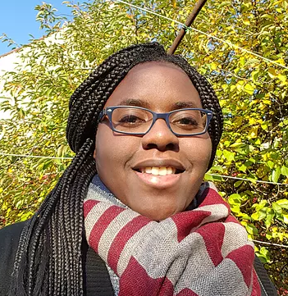
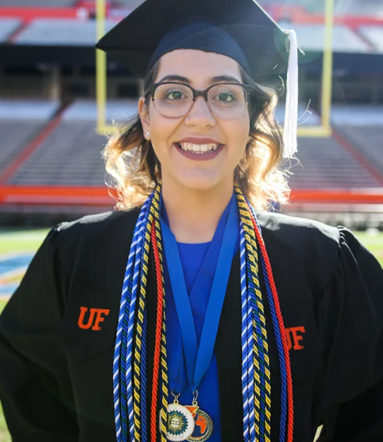
SURVEY RESULTS
Results by Sex & Race/Ethnicity
20. I enjoy learning about other cultures
23. I appreciate differences between cultures
Who?
18. When working on a group project, I enjoy collaborating with students from other countries.
19. I often ask questions about culture to members of other cultures
UF IntCRIT & IntCOMM Attitudes and Beliefs Survey

Slide 10
COMPARISON BY SEX

Slide 11
SURVEY RESULTS
Comparison by Sex
To capture the effect of sex, analysis of variance (ANOVA) was conducted on 25 items at the alpha level of 0.05
Categories?
Male/Female/ Non-binary
Differences?
Found significant differences (male/female) in 19 out of 25 items
Who scored higher?
On significant items, females scored higher on all items but three.
UF IntCRIT & IntCOMM Attitudes and Beliefs Survey

Slide 12
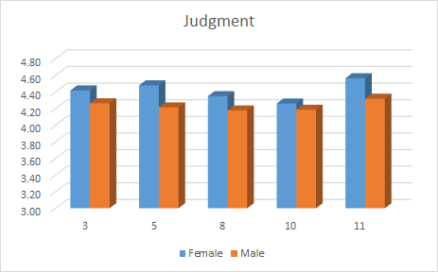
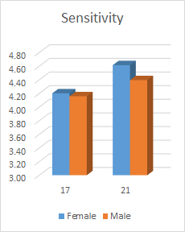
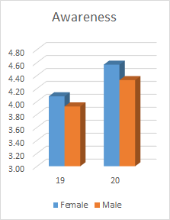
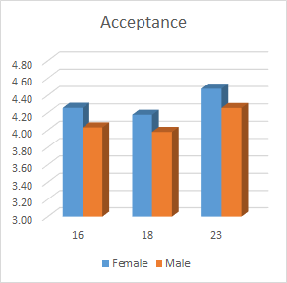
Comparison by Sex
Females scored higher on all items in the Judgment (Critical Thinking) and in Sensitivity, Awareness and Acceptance (Communication) .
UF IntCRIT & IntCOMM Attitudes and Beliefs Survey

Slide 13
RACE & ETHNICITY

Slide 14
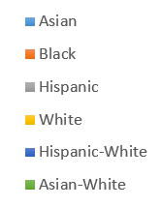
SURVEY RESULTS
Race/Ethnicity Comparison
Categories?
Differences?
Significant race/ethnicity differences in all items
An ANOVA was used again on 25 items at alpha level of 0.05 to see if there is any race differences. Then, since there are more than two categories within ethnicity/race, multiple comparison procedures were performed to find pairwise differences
UF IntCRIT & IntCOMM Attitudes and Beliefs Survey

Slide 15
SURVEY RESULTS
Race & Ethnicity Comparison
Critical Thinking
Judgement
Analysis
Reasoning
Solution Finding
UF IntCRIT & IntCOMM Attitudes and Beliefs Survey

Slide 16
SURVEY RESULTS
Race & Ethnicity Comparison
Communication
Sensitivity
Production
Awareness
Adaptability
Acceptance
UF IntCRIT & IntCOMM Attitudes and Beliefs Survey

Slide 17
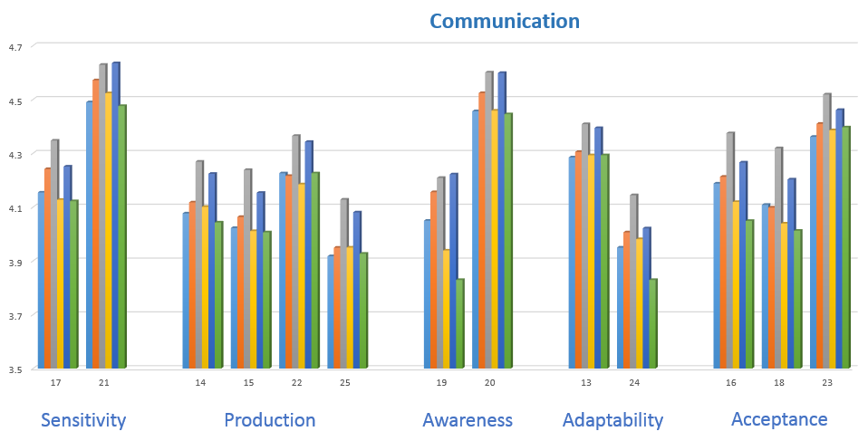
SURVEY RESULTS
Race/Ethnicity Comparison
Who scored higher?
Hispanic students performed significantly better than White students in all items but one.
Hispanic-White students performed significantly better than White students in all items but two.
Hispanic students performed significantly better than Asian students in most Communication components.
UF IntCRIT & IntCOMM Attitudes and Beliefs Survey

Slide 18
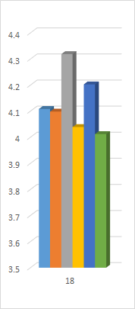
SURVEY RESULTS
Race/Ethnicity Comparison
18. When working on a group project, I enjoy collaborating with students from other countries.
Hispanic
Hispanic-White
Asian
Black
White
Statistical significant differences:
Asian White
Race/Ethnicity | Mean Difference | P-value
Hispanic/Asian-White​ | 0.31 | 0.004
Hispanic/White​ | 0.28 | < 0.001
Hispanic/Asian​ | 0.21 | < 0.001
Hispanic/ Black | 0.22 | < 0.001
Hispanic-White/White​ | 0.16 | < 0.001
UF IntCRIT & IntCOMM Attitudes and Beliefs Survey

Slide 19
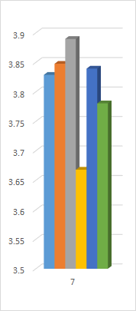
SURVEY RESULTS
Race/Ethnicity Comparison
Hispanic
7. I actively learn about different cultural norms.
Black
Hispanic-White
(Lowest-ranked item in survey overall: 3.77 in 1-5 scale)
Asian
Asian White
Statistical significant differences:
White
Race/Ethnicity | Mean Difference | P-value
Hispanic/White​ | 0.22 | < 0.001
Black/White​ | 0.18 | 0.040
Hispanic-White/White​ | 0.17 | 0.009
Asian/White​ | 0.16 | 0.001
UF IntCRIT & IntCOMM Attitudes and Beliefs Survey

Slide 20
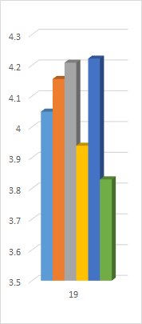
SURVEY RESULTS
Race & Ethnicity Comparison
19. I often ask questions about culture to members of other cultures.
Hispanic-White
(This is the most varied question with 8 significant differences).
Hispanic
Black
Asian
Statistical significant differences:
White
Race/Ethnicity | Mean Difference | P-value
Hispanic/Asian​ | 0.16 | 0.001
Hispanic-White/Asian​ | 0.17 | 0.014
Asian/White​ | 0.11 | 0.050
Black/Asian-White​ | 0.33 | 0.022
Hispanic/Asian-White​ | 0.38 | 0.002
Hispanic-White/Asian-White​ | 0.39 | 0.001
Black/White​ | 0.22 | < 0.001
Hispanic/White​ | 0.27 | < 0.001
White/Hispanic-White | 0.28 | < 0.001
Asian White
UF IntCRIT & IntCOMM Attitudes and Beliefs Survey

Slide 21
Reframing Deficit Narratives

Slide 22
How do we define excellence?

Slide 23
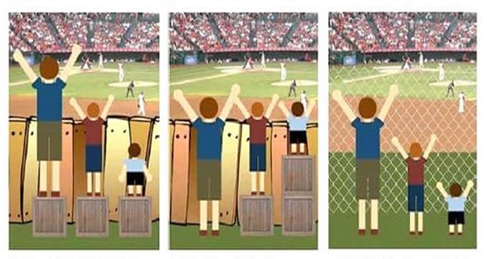

Slide 24
Strength-based Learning
How might your definition of excellence limit your understanding of everyone’s strengths?
Do you think that your students are aware of their strengths? If not, how might you help them understand their own assets?
How can you leverage the strengths of your students and take them to the next level? Consider:
Bilingualism
Cultural & familial background
Resilience & strategies for success
How can you help students become aware of their own deficits and build a plan of action?
What skills do you think employers are seeking? How could you use this data to educate students about skill development?

Slide 25
THANK YOU!
Timothy Brophy, Ph.D.
Director of Institutional Assessment
tsbrophy@ufl.edu
Mary Kay Carodine, Ph.D.
Asst. VP Student Affairs
mkcarodine@ufsa.ufl.edu
Paloma Rodriguez
Director Office of Global Learning
prodriguez@ufic.ufl.edu

