Slide 1
Fostering Collaboration via
Building Community
Maha Bali, PhD @bali_maha
Center for Learning & Teaching, American University in Cairo,
Virtually Connecting & Equity Unbound
Interface Keynote, April 14, 2021
Slide deck co-designed w my daughter H.Fouad

Slide 2
السلام عليكم
Ramadan Kareem
Image of Ramada lanterns by Rawan Yasser on Unsplash: https://unsplash.com/photos/Y-joaXX7XCQ

Slide 3
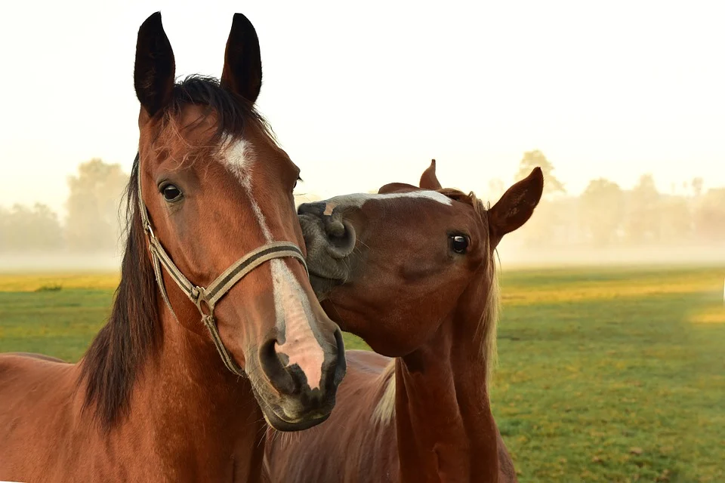
Sleepless in Seattle:
How are you feeling? Where are you?
Image from Pixabay https://pixabay.com/photos/horses-kiss-play-affection-3747374/

Slide 4
Plan for this session
Checking in
Chatterfall
Building community to foster collaboration
Experience Troika consulting
Sharing back
Design decisions
Key takeaway
Max Kleinen on Unsplash

Slide 5
These slides are open for commenting:
http://bit.ly/interfacebali

Slide 6
Chatterfall
Please
respond in the chat
Elijah Hiett on Unsplash

Slide 7
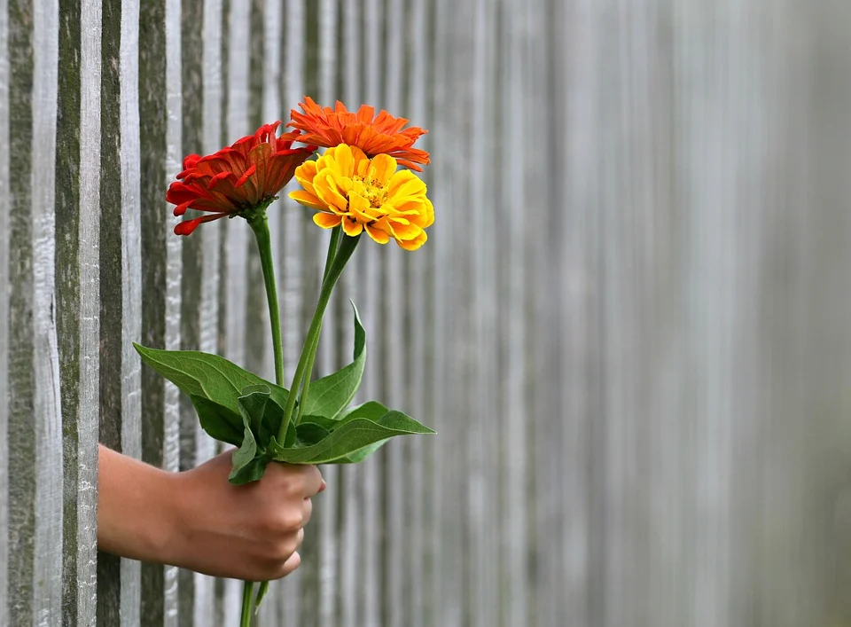
These days, I am grateful for...
Image from Pixabay: https://pixabay.com/photos/hand-gift-bouquet-congratulation-1549399/

Slide 8
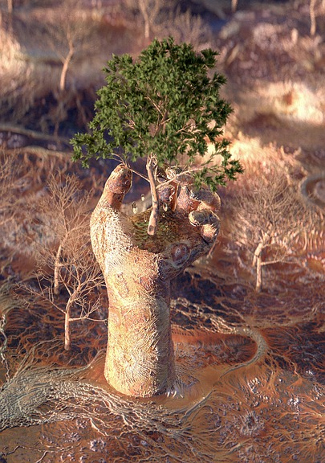
My superpower is....
Image from Pixabay

Slide 9
A big challenge of collaboration online is...
Image from Pixabay: https://pixabay.com/photos/sunset-beach-silhouettes-jump-570881/

Slide 10
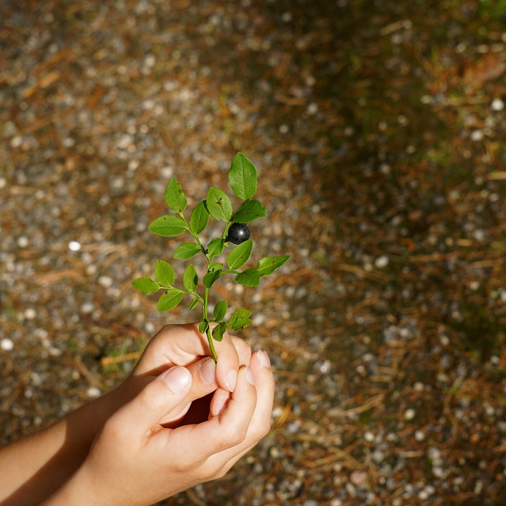
One thing students really need these days is...
Image from: https://pixabay.com/photos/hand-reach-out-show-twig-blueberry-212810/

Slide 11
Building community as a foundation for fostering collaboration
https://onehe.org/equity-unbound

Slide 12
Creating safety vs expecting trust
How?
Image from Pixabay: https://pixabay.com/illustrations/hands-network-hand-rainbow-color-5319690/

Slide 13
Developing “community participation guidelines together”? Revising them?

Slide 14
Introductions and beyond...
Image from Pixabay https://pixabay.com/photos/laptop-apple-macbook-computer-2585705/

Slide 15
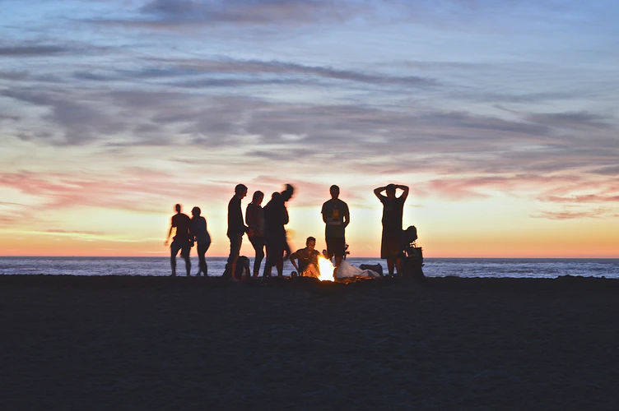
Warm-ups and low-stakes community building
Photo by Kimson Doan on Unspash

Slide 16
Equitable ongoing engagement:
Equitable processes
Choice/Agency
Diversity

Slide 17
Modeling care and empathy
Photo from Tarikul Roaana on Unsplash

Slide 18
Care with Parity of Participation
"In the caring approach, we would prefer to advise: do unto others as they would have done unto them." (Noddings)
I say: “Do unto students as THEY would have done unto THEM)
Noddings, N. (2012). The language of care ethics. Knowledge Quest, 40(5), 52.
Bali, M. (2020). https://www.timeshighereducation.com/campus/do-unto-students-they-would-have-done-them

Slide 19
Levels of Care & Intentional Equity
How do you show it at each level?
(see blogpost)
Personal/Private
Respond in Situations
Habitual practices in class
Course philosophy, design, planning
Notes:
Ideas from my blogpost: https://blog.mahabali.me/educational-technology-2/pedagogy-of-care-covid-19-edition/

Slide 20
Troika Consulting for Reciprocity
A Liberating Structure
Get Practical and Imaginative Help from Colleagues Immediately

Slide 21
What are Liberating Structures?
Liberating Structures - Introduction
Virtual:
https://virtual-liberating-structures.gdes.app/
Also: **Mobile app**
Notes:
Liberating Structures are simple unconventional techniques to make people work together, generate ideas, solve problems, and have everyone’s voice heard. Liberating Structures are easy-to-learn and practice microstructures that enhance relational coordination and trust, tap into collective intelligence, stimulate creativity. Some of the key elements teachers need to address in online education, are to create spaces where students can develop a sense of belonging and trust that they are not judged. These Liberating Structures address these two key elements, because they allow for lively participation in groups where everyone is included and can unleash their ideas.

Slide 22
Timings - 10 mins/round, usually 3 rounds
Take a picture of these instructions
Explain your challenge [1m]
Clarifying questions [1-2m]
Client turns their back and LISTENS (no talking - camera off & mute)
Consultants discuss with each other [5m]
Debrief [1-2m]
Turn back again, share reflections
GDS
Notes:
1 round take 9-10 minutes.

Slide 23
Debrief: how was that experience?
Image from Pixabay: https://pixabay.com/photos/handshake-hands-laptop-monitor-3382503/

Slide 24
Design decisions that help or hinder collaboration
Whole group learning vs small group learning
Phasing projects with milestones vs one large deliverable
Supporting students with time management, project management & metacognition (knowing their strengths and weaknesses so they can build on each other's strengths)
Humor and safe space for making mistakes
Agency and choice over what and how (with whom?)
Modeling Intentionally Equitable Hospitality
Peer feedback/support

Slide 25
Intentionally Equitable Hospitality
Bali, Caines, Hogue, DeWaard & Friedrich (2019)

Slide 26
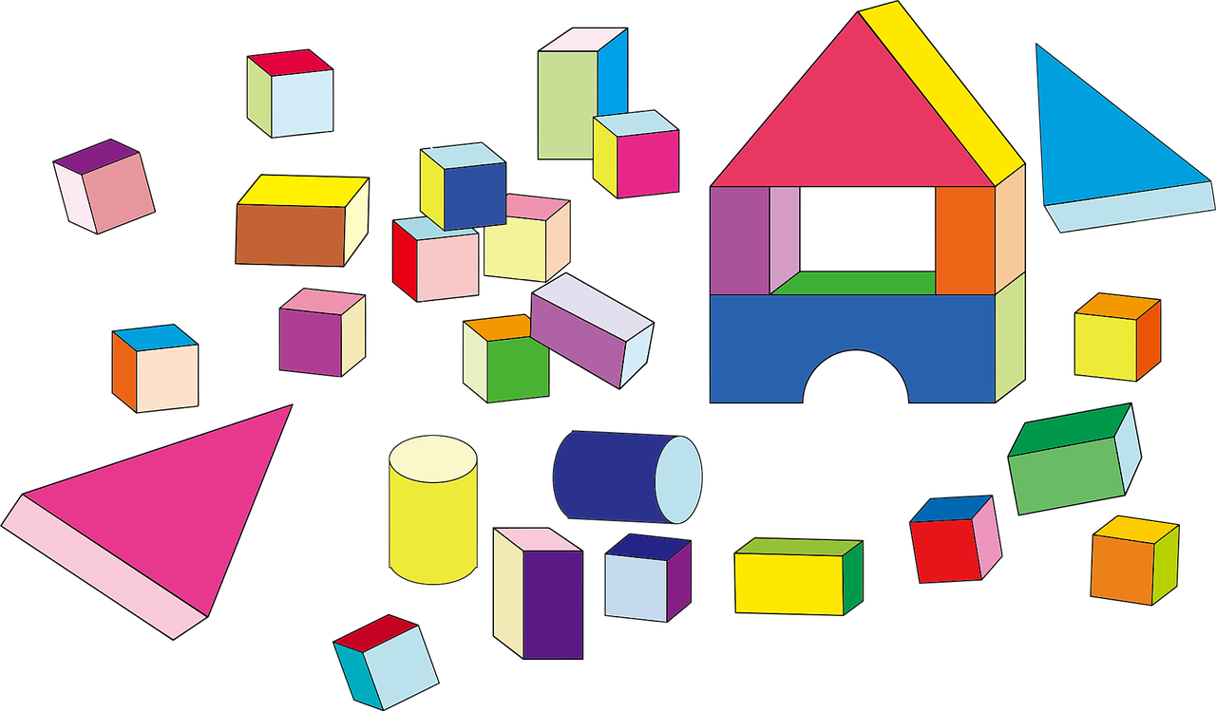
Intentionally Equitable Hospitality
You are a “host” building the space Hospitality is your responsibility - Whom do you involve/listen to? How do you make each person welcome?
Image by OpenClipart-Vectors from Pixabay

Slide 27
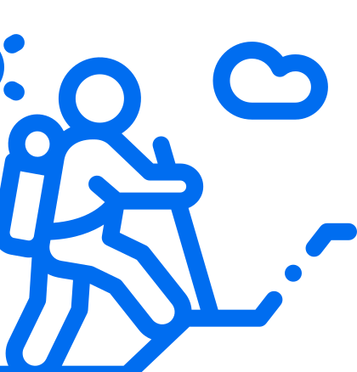
Intentionally Equitable Hospitality
Set your intention. Walk the talk. It won’t happen automatically or easily, so you need to set the intention - it is not enough to say “oh, I didn’t realize”

Slide 28
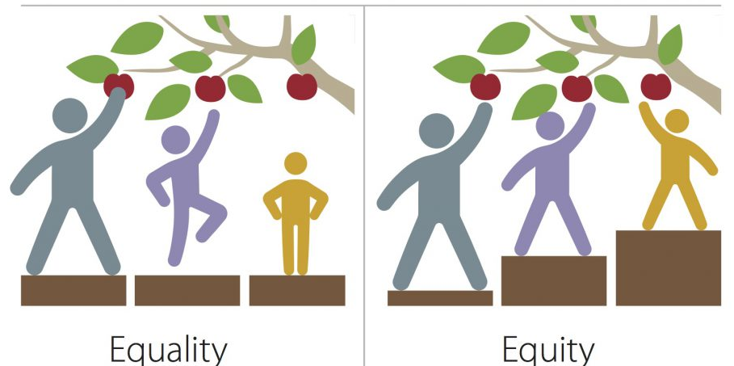
Intentionally Equitable Hospitality
Recognize that if you intend to be hospitable to ALL students, you need to pay attention to the inequities faced by EACH student

Slide 29
Debrief: One key takeaway or some immediate action you will take after today

Slide 30
Thank You!
Slides: http://bit.ly/interfacebali
Email: bali@aucegypt.edu
Twitter: @bali_maha
Feedback: http://bit.ly/balikeynotes
(Some graphics by my daughter, H. Fouad)

